Slide 1
Port to Port
A slideshow of images from Museums Victoria's collection documenting the experience of post war migrants arriving to Australia by boat in the 1940s, 50s and 60s.

Slide 2
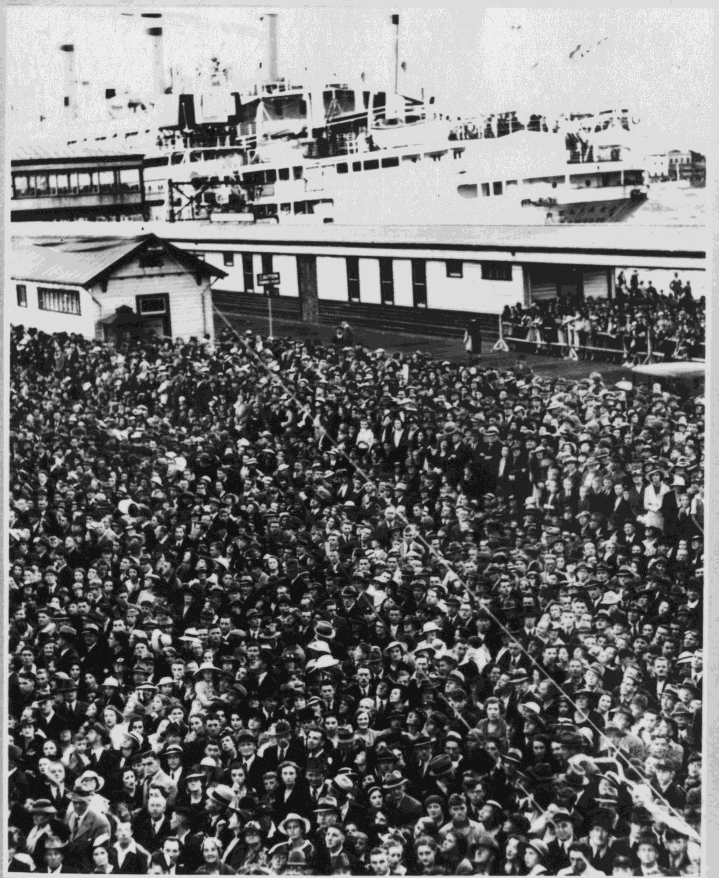
Vessel Reliance (Hamburg) at Station Pier
Photographer: Unknown

Slide 3
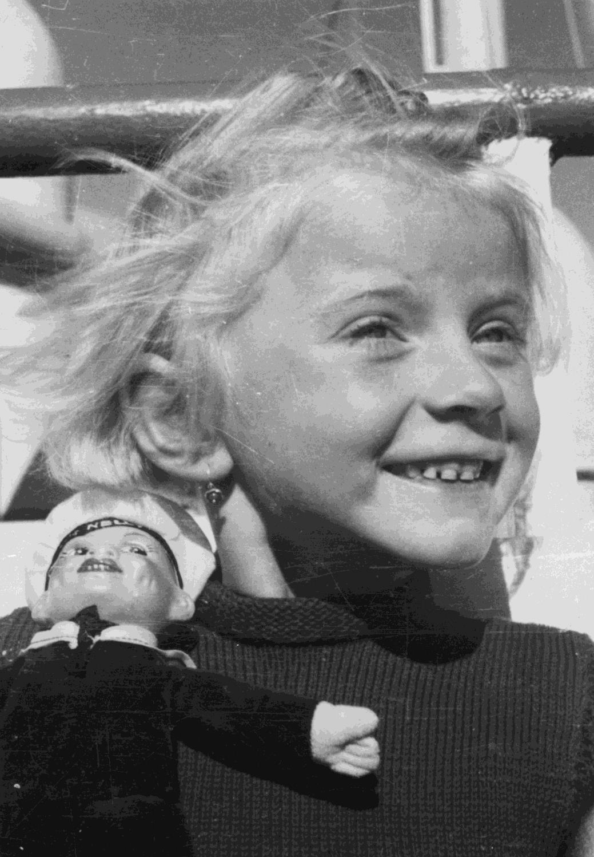
Young girl with ship's souvenir
Photographer: Unknown

Slide 4
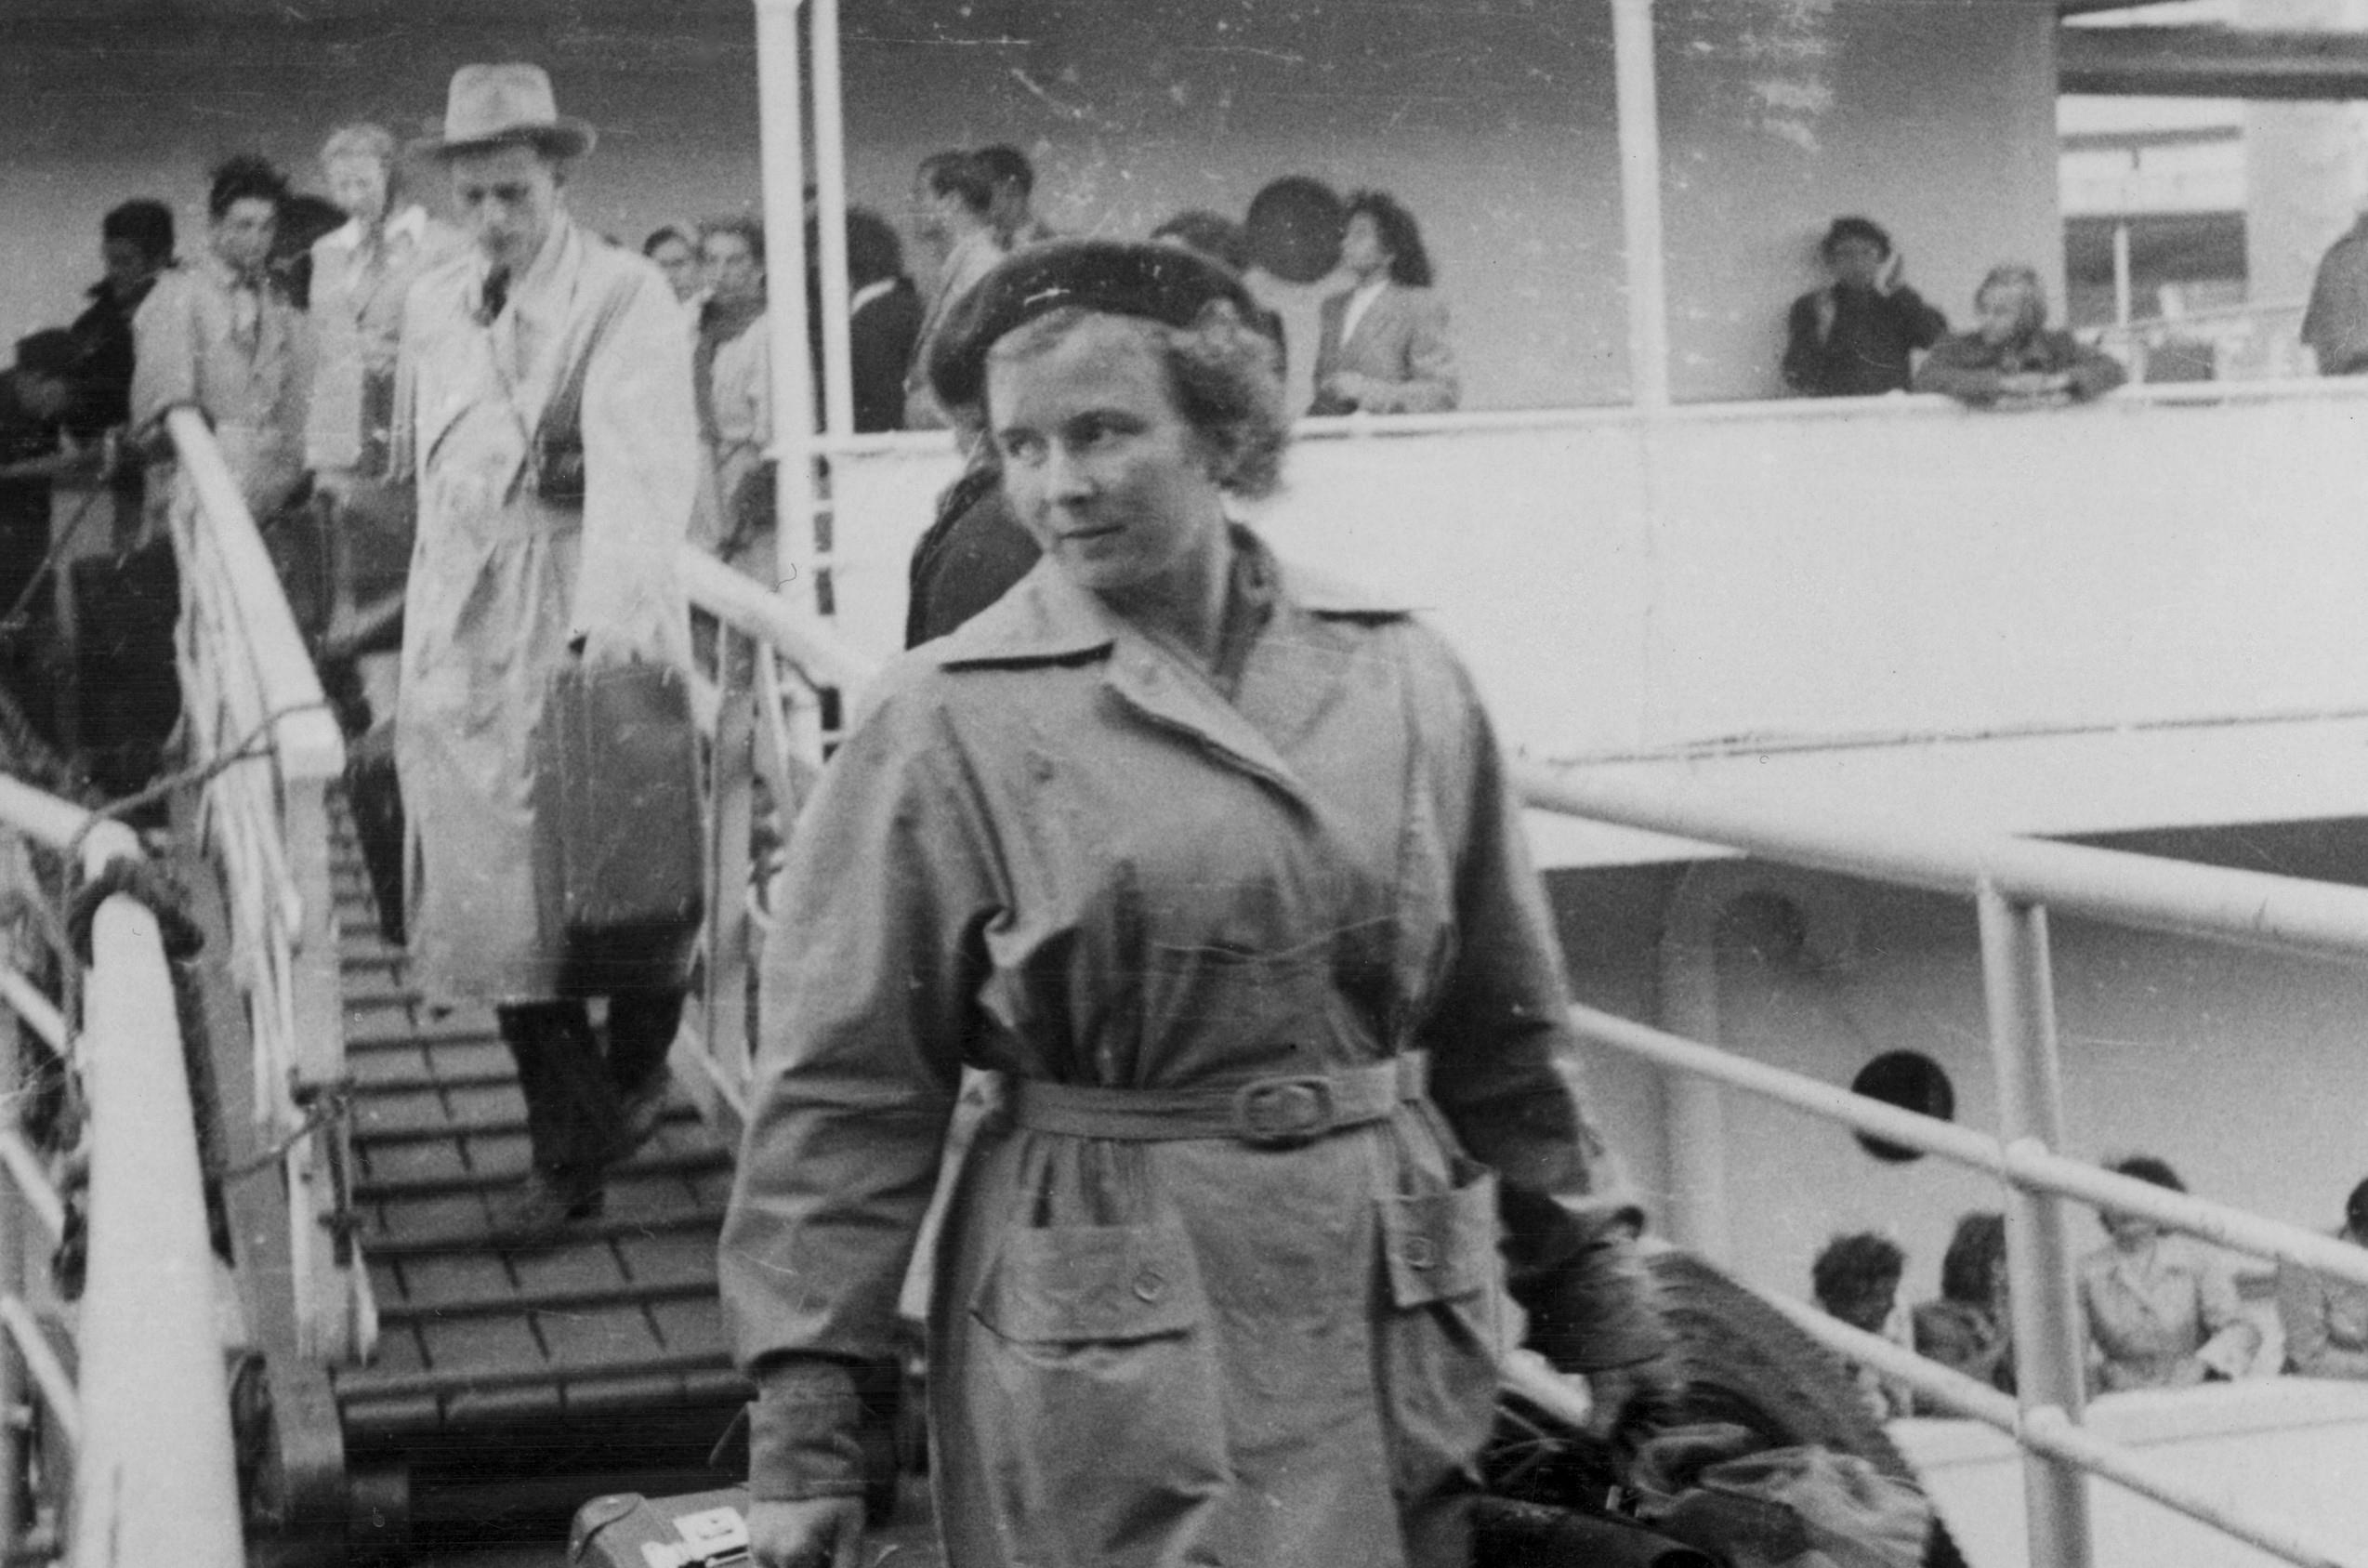
Woman at Station Pier
Photographer: unknown

Slide 5
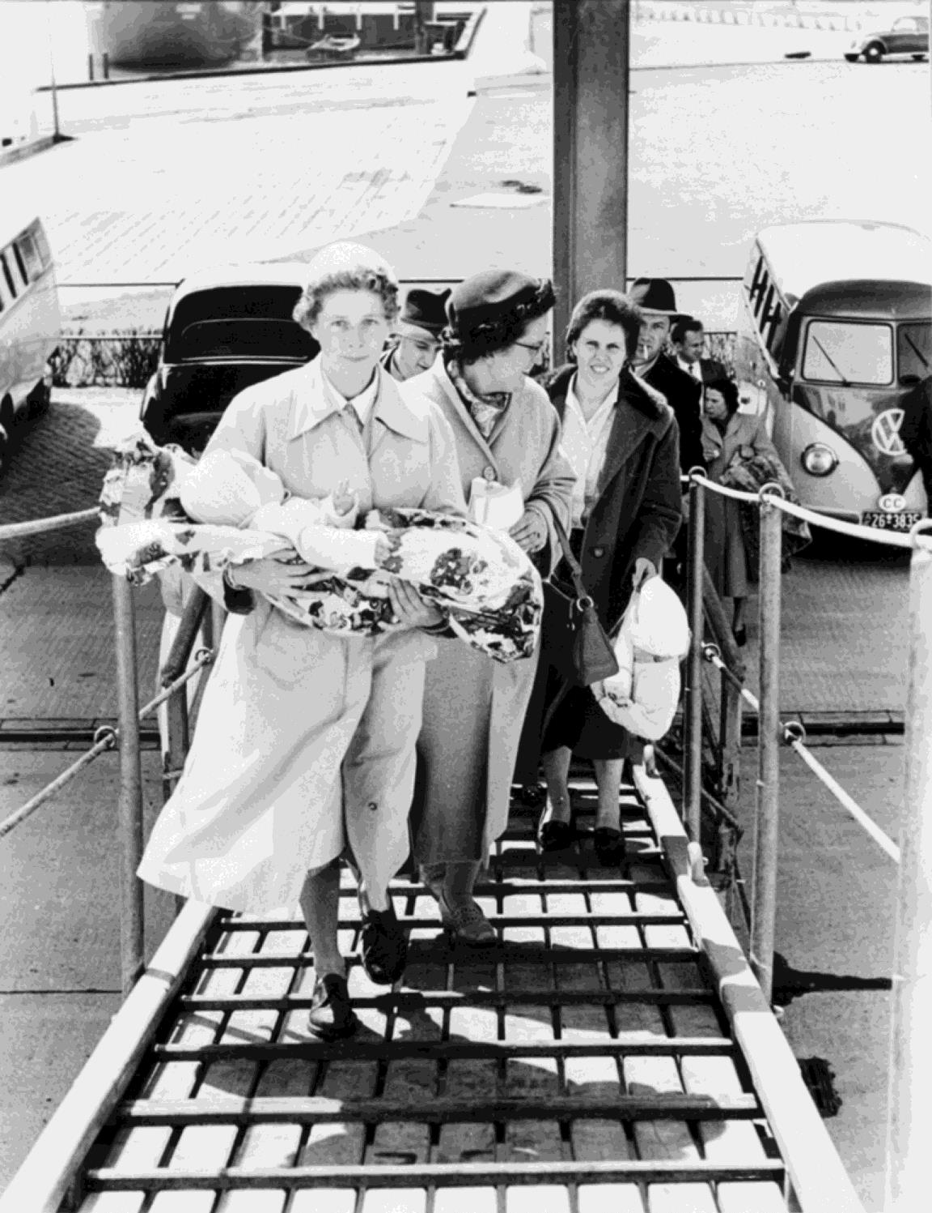
Embarkation on the 'Fairsea', Bremerhaven, 1956. Mother with baby leads the charge up the gangway
Photographer: unknown

Slide 6
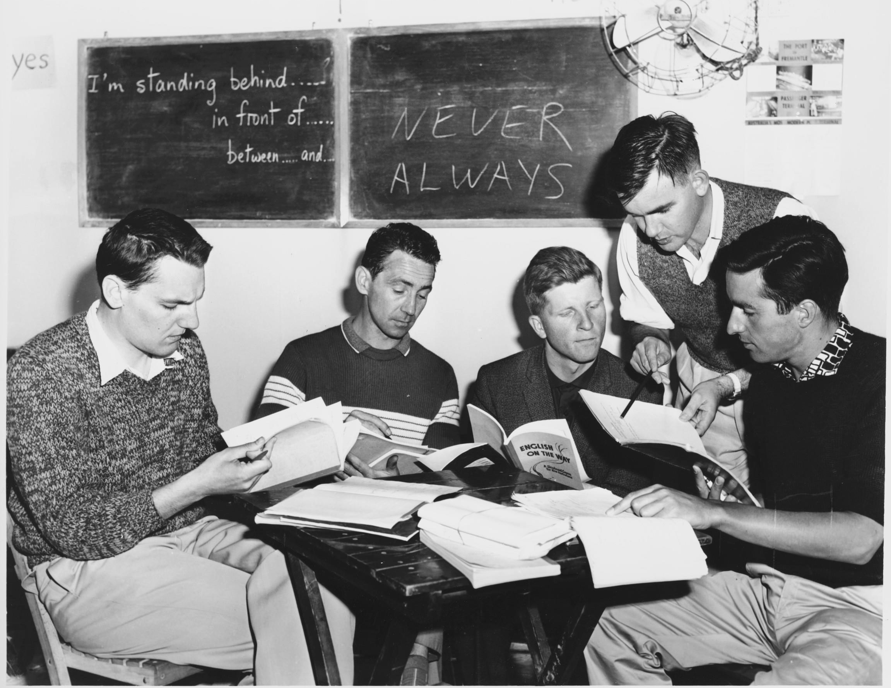
Shipboard education officer Derek Swan briefs voluntary assistant teachers recruited from passengers. Taken on board liner Fairsea
Photographer: Don Edwards

Slide 7
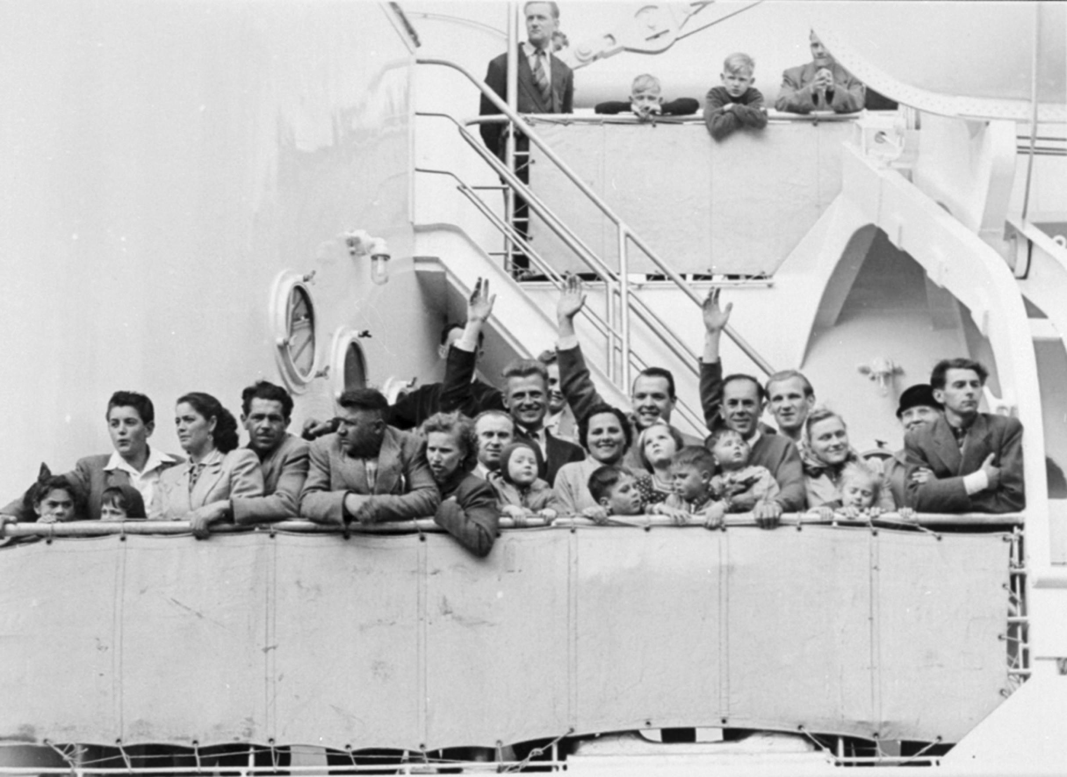
Embarkation on the Fairsea, Bremerhaven 1956 with passengers waiving from deck railing
Photographer: unknown

Slide 8
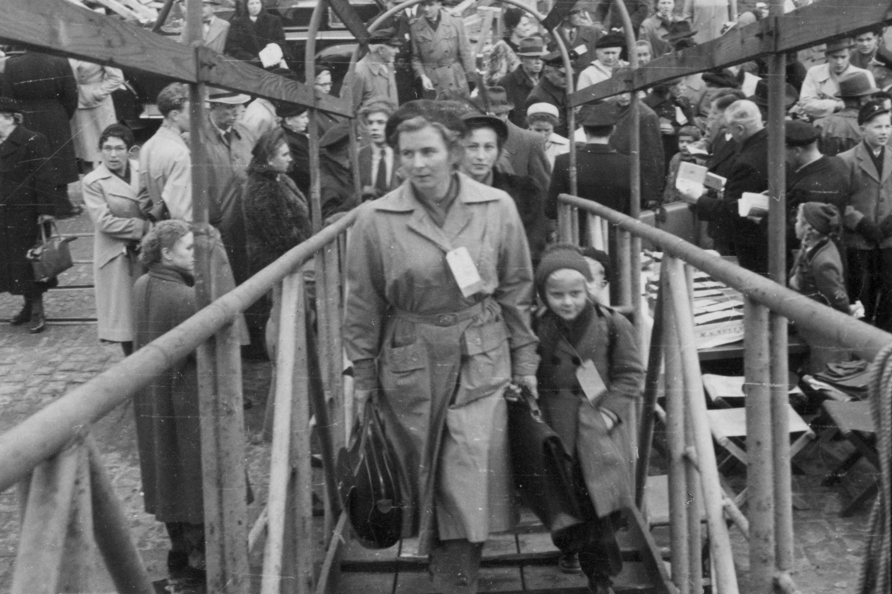
Woman and daughter boarding ship
Photographer: unknown

Slide 9
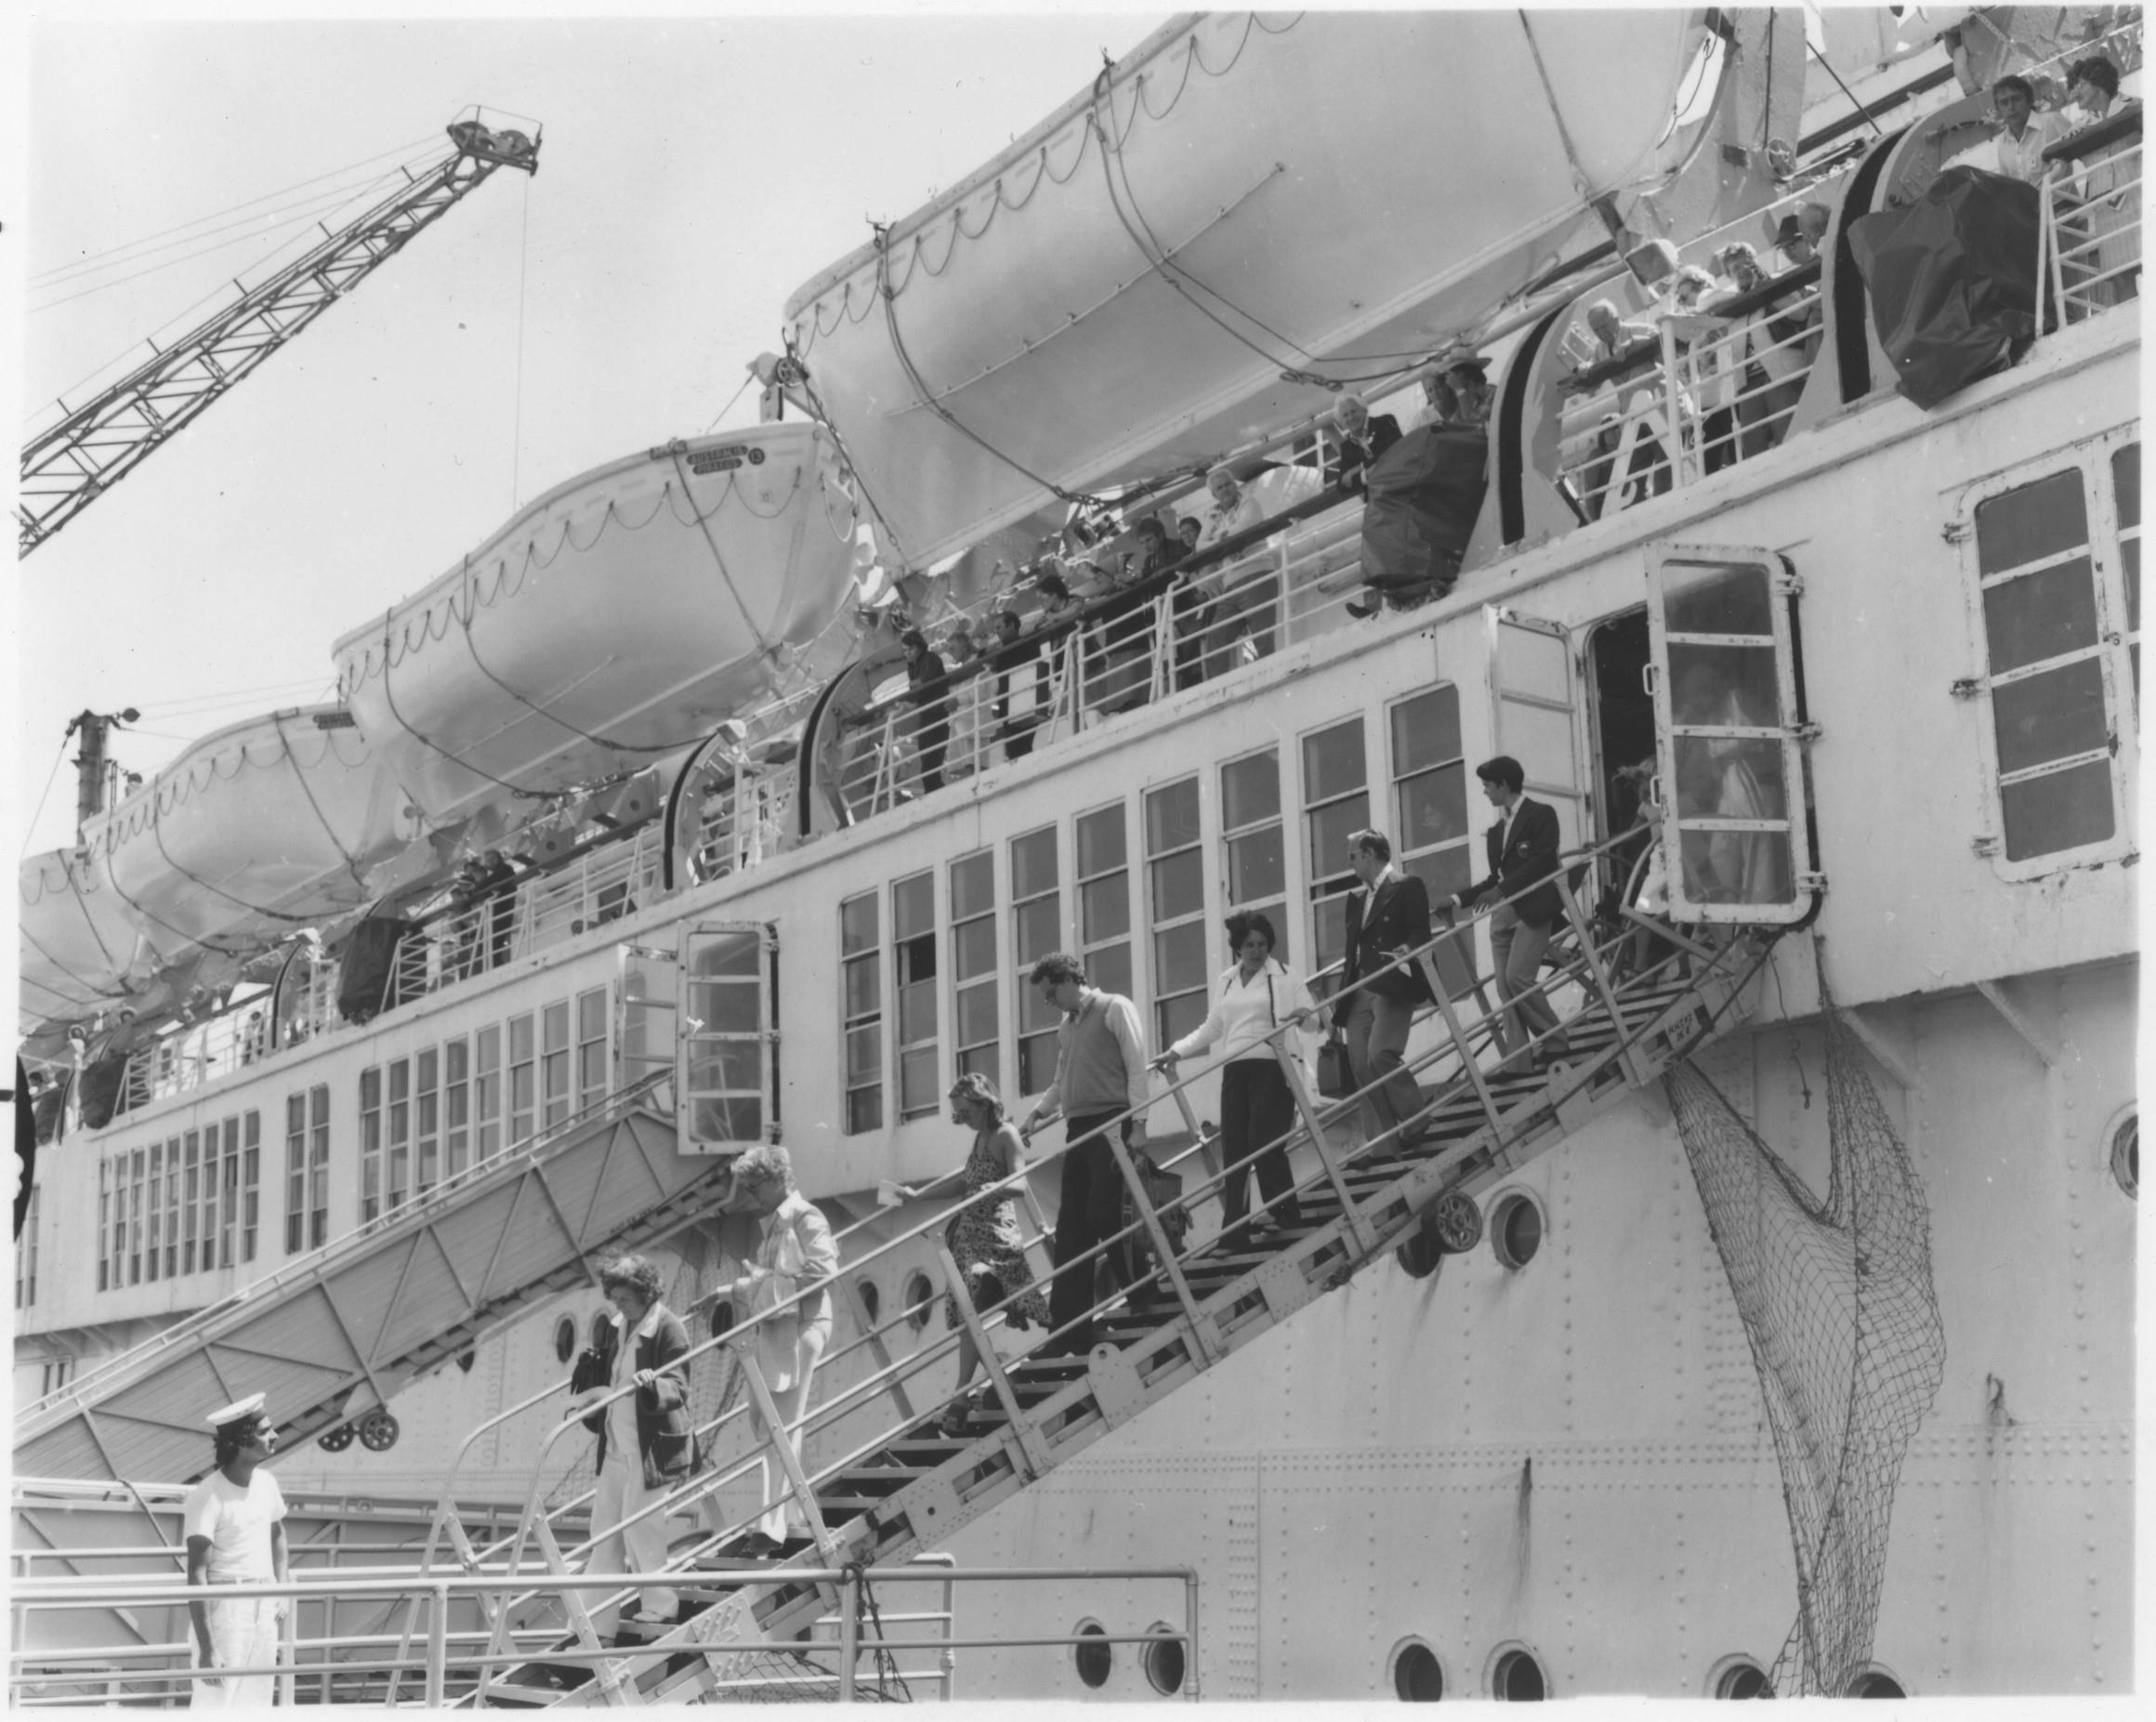
People disembarking ship, Station Pier, Port Melbourne
Photographer: unknown

Slide 10
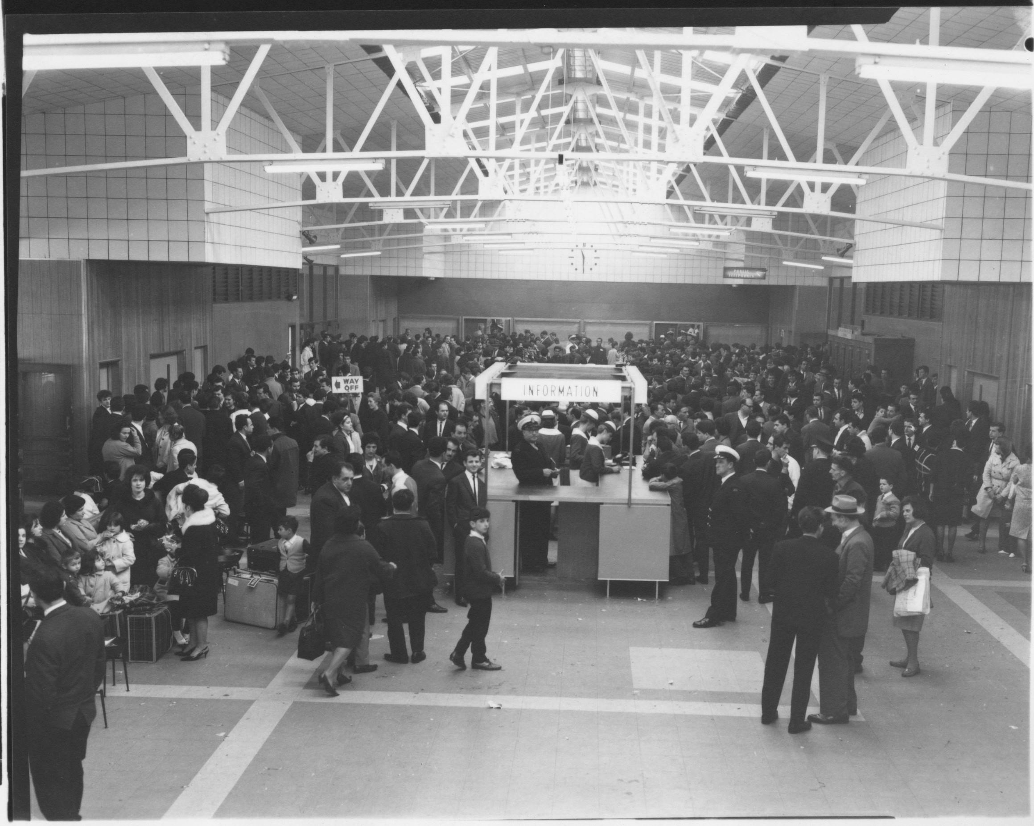
Information desk at Port Authority, Station Pier
Photographer: unknown

Slide 11
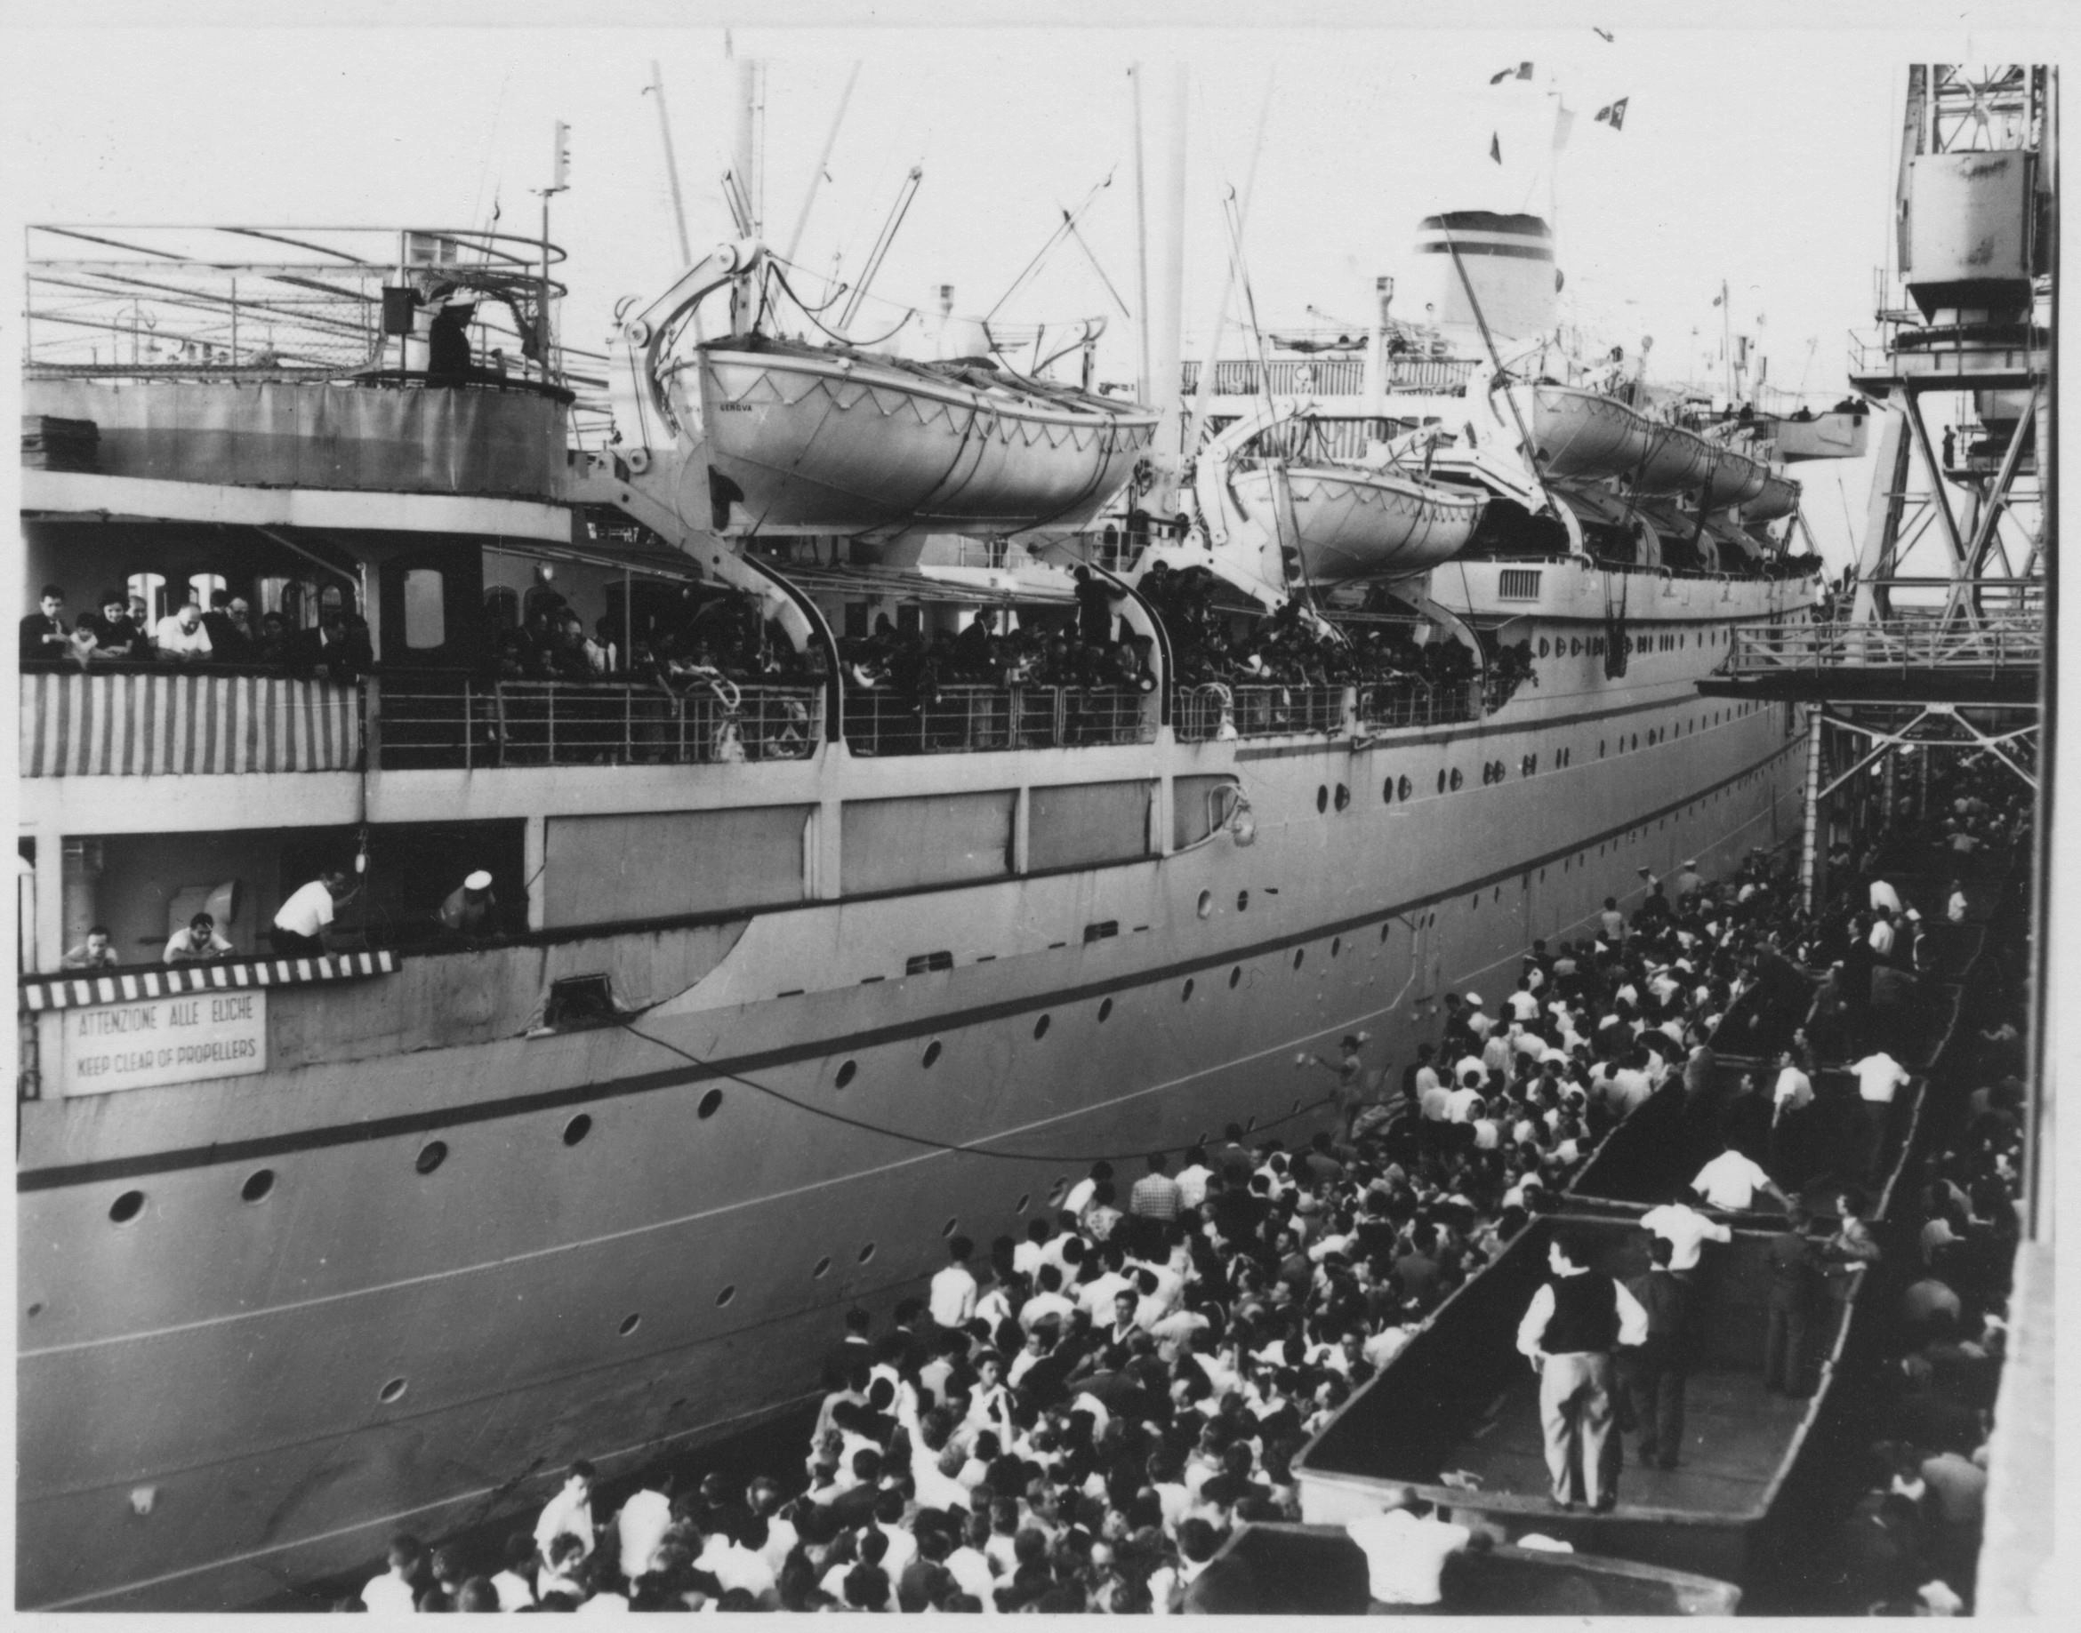
Italian migrants arrive on the Neptunia ship at Station Pier
Photographer: unknown

Slide 12
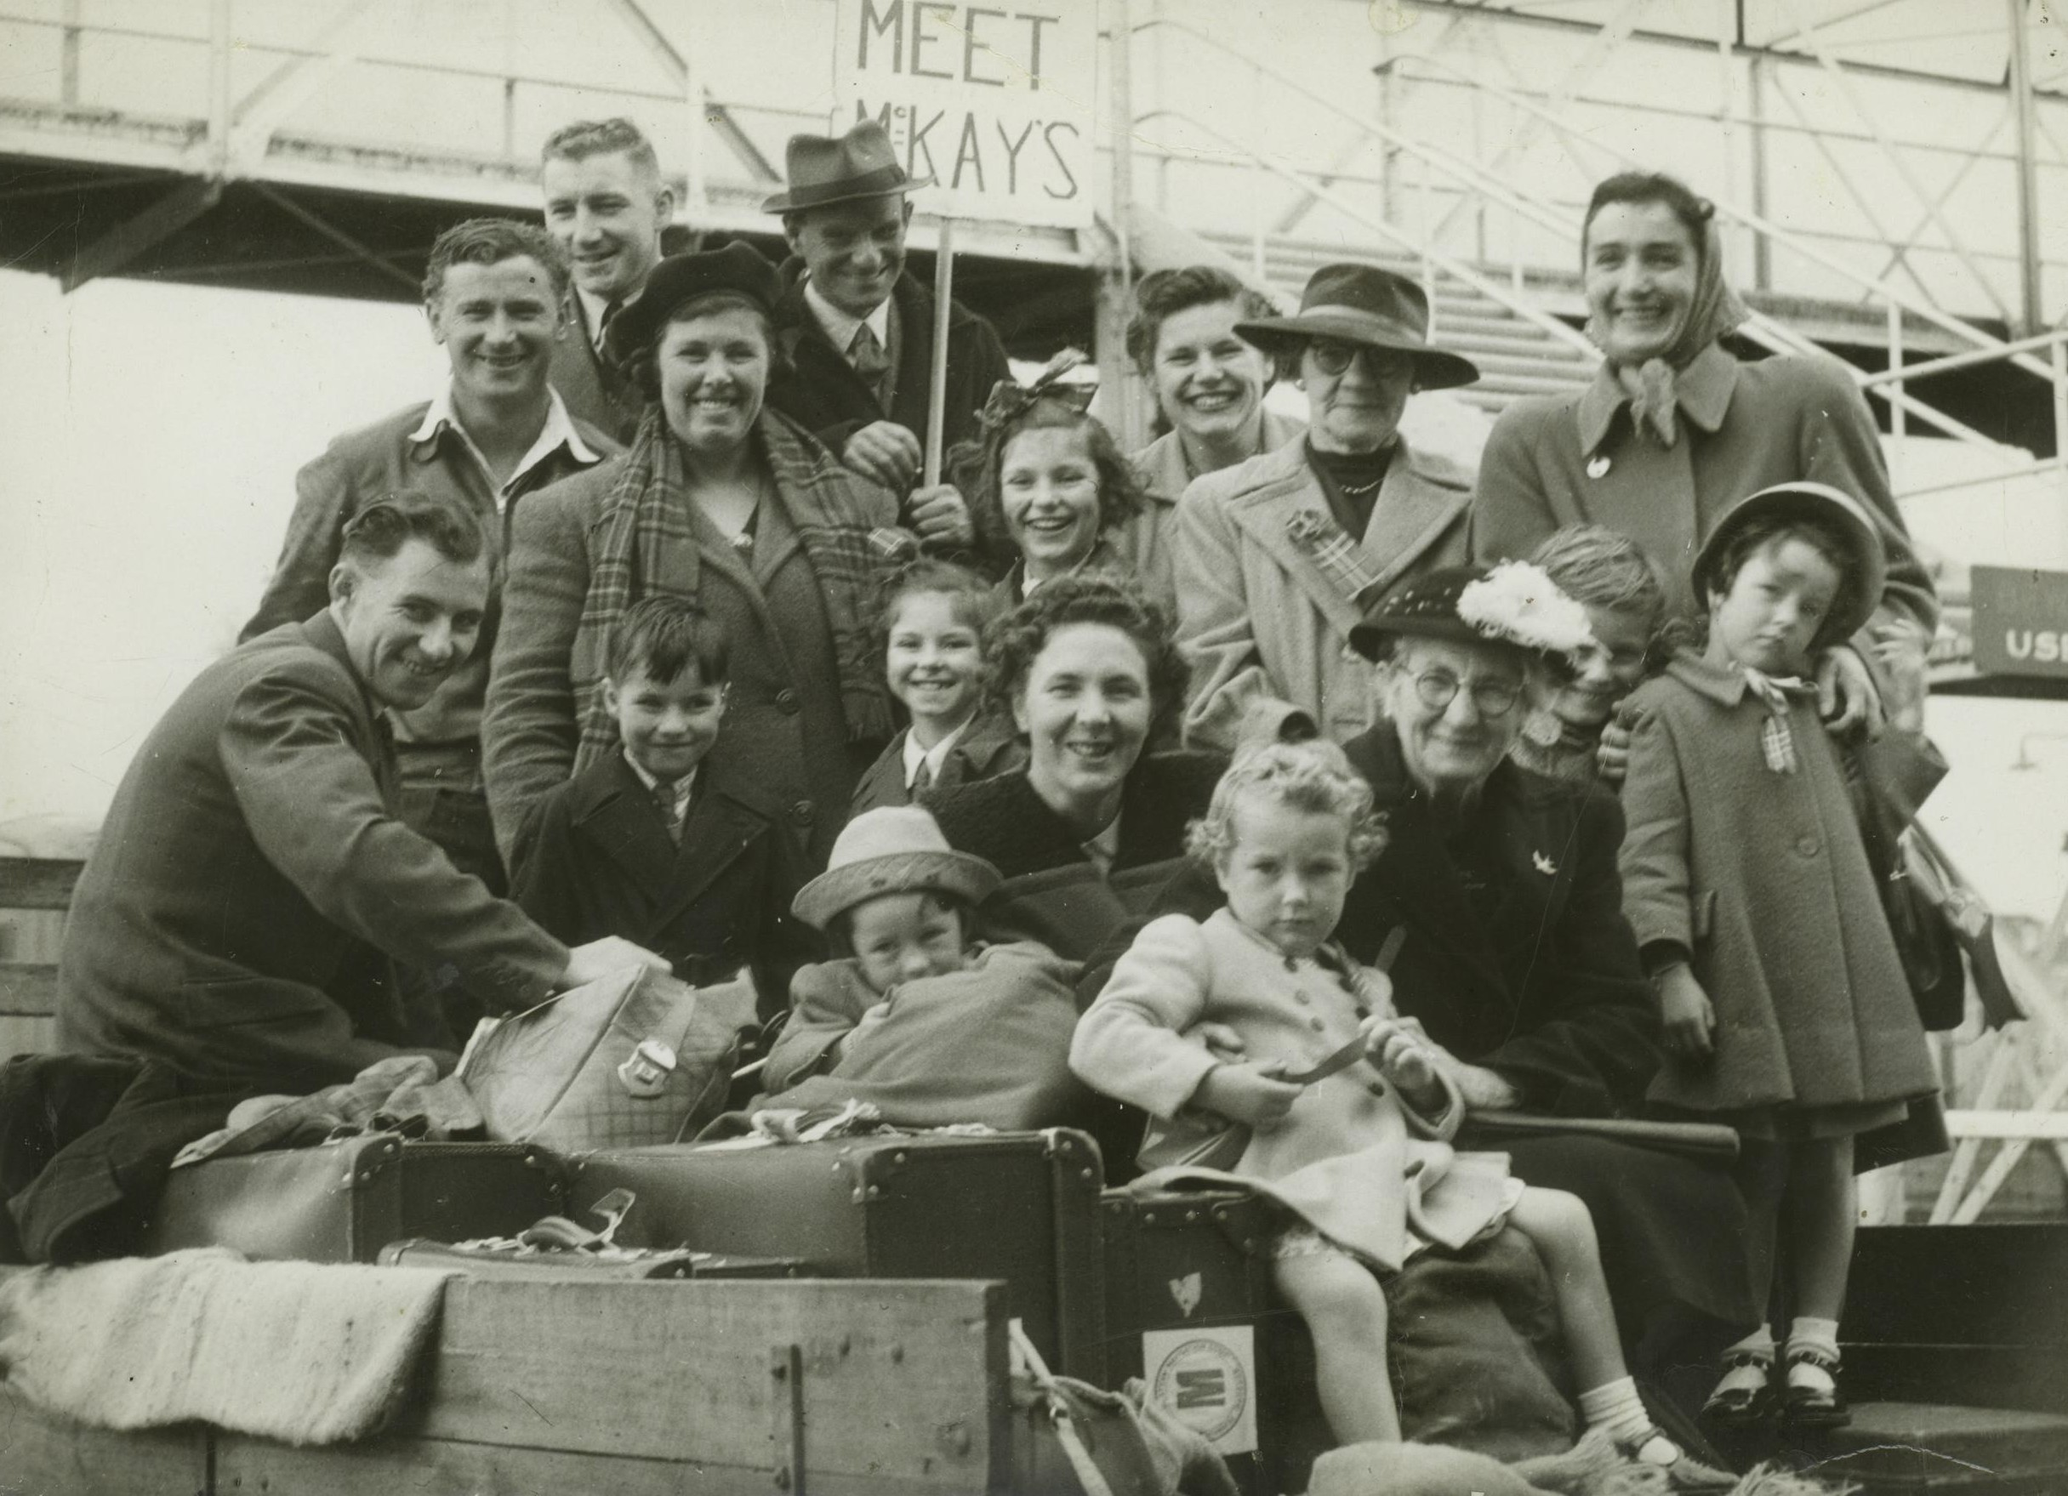
The Mackay family and Australian relatives at Station Pier 25th March 1950
Photographer: unknown

Slide 13
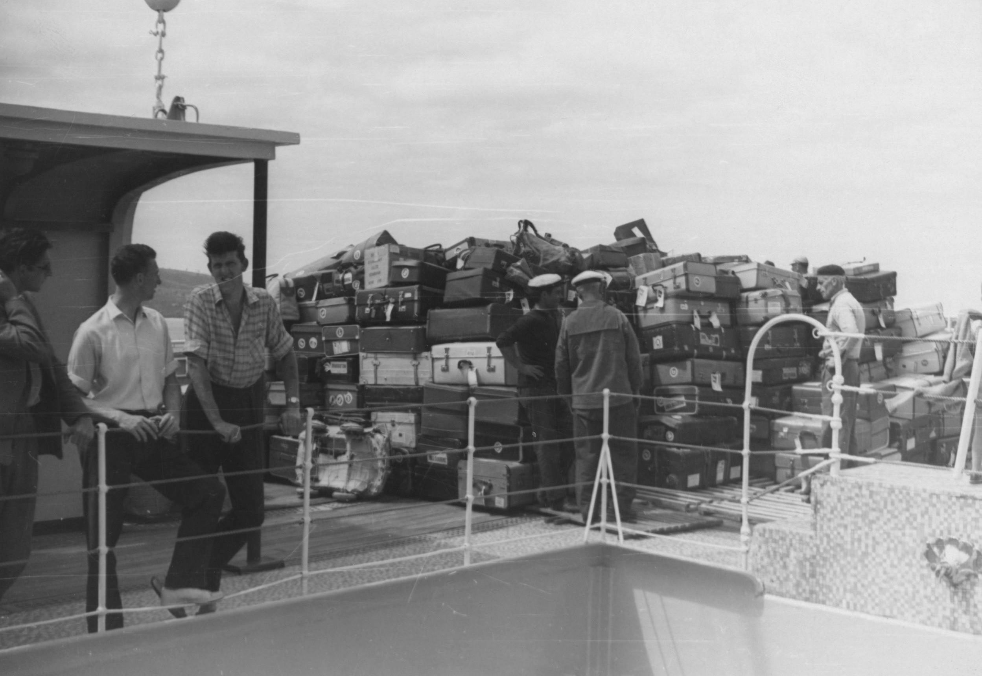
Piles of luggage to be unloaded
Photographer: unknown

Slide 14
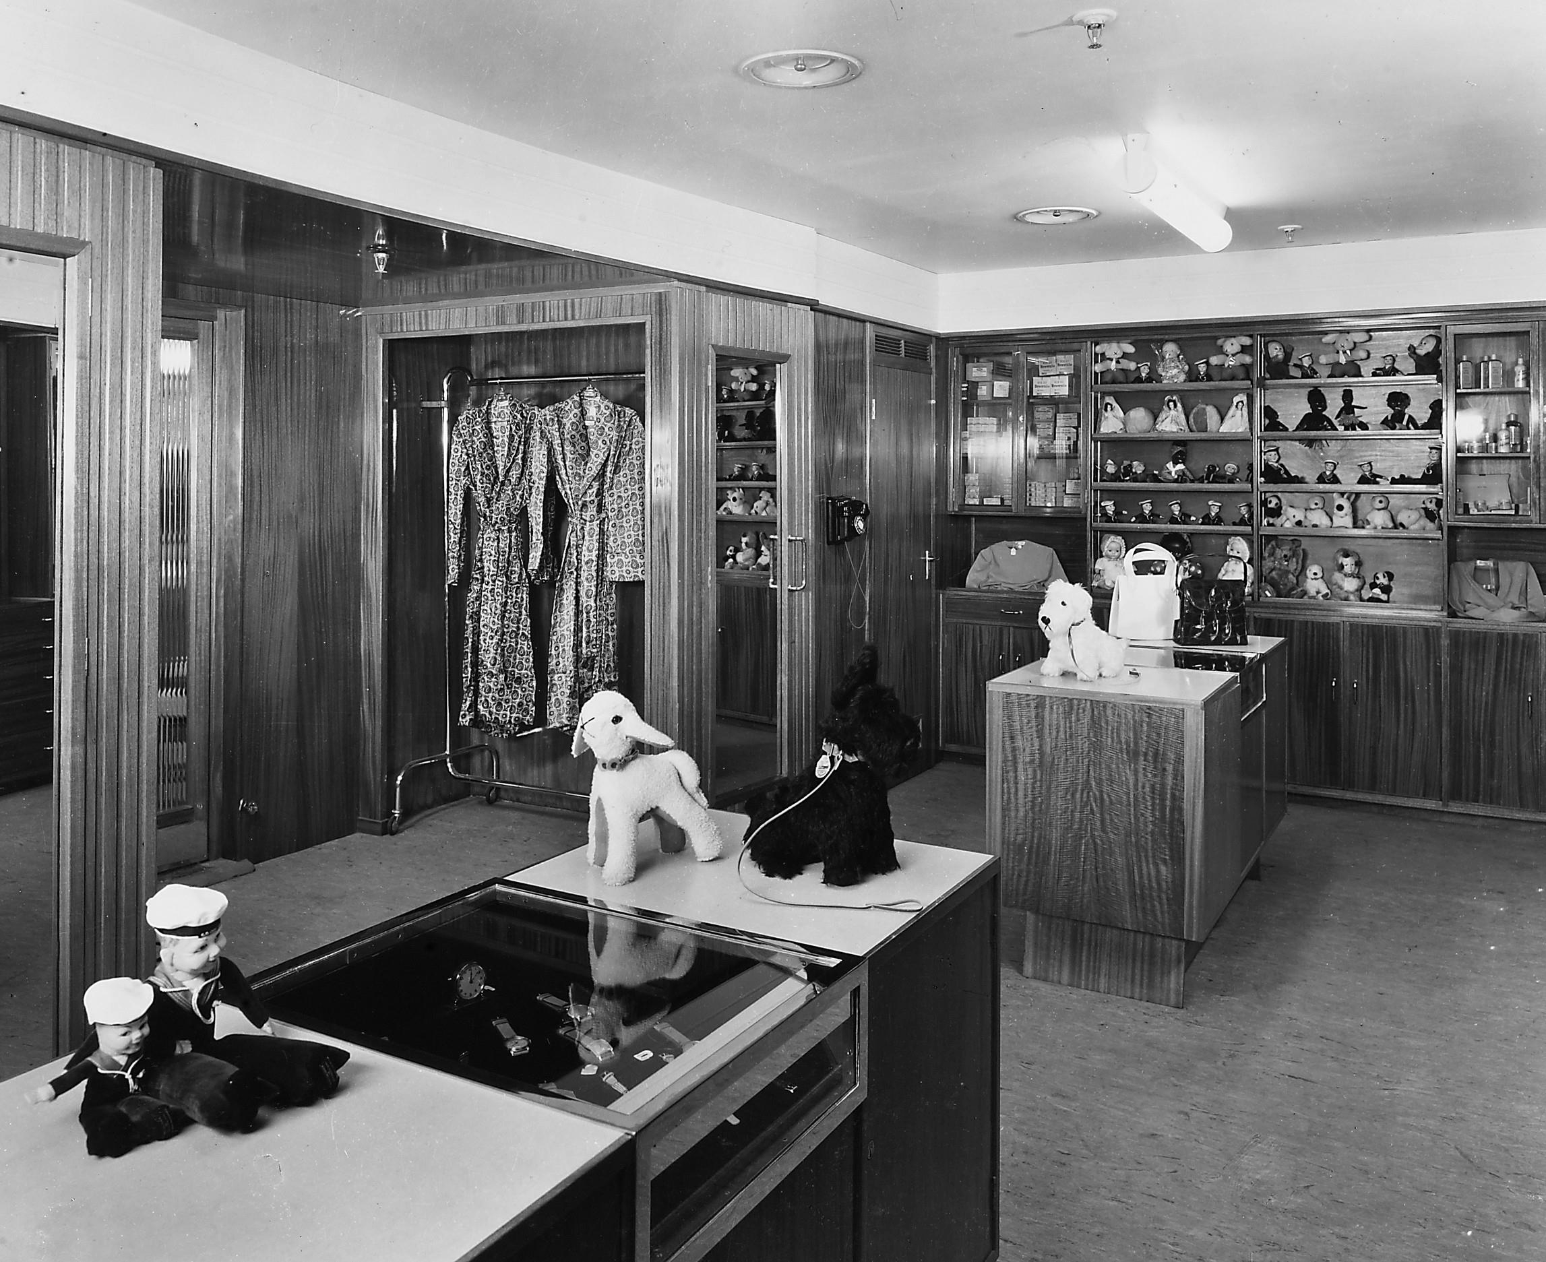
The Souvenir shop on the Orcades ship, in first class
Photographer: unknown

Slide 15
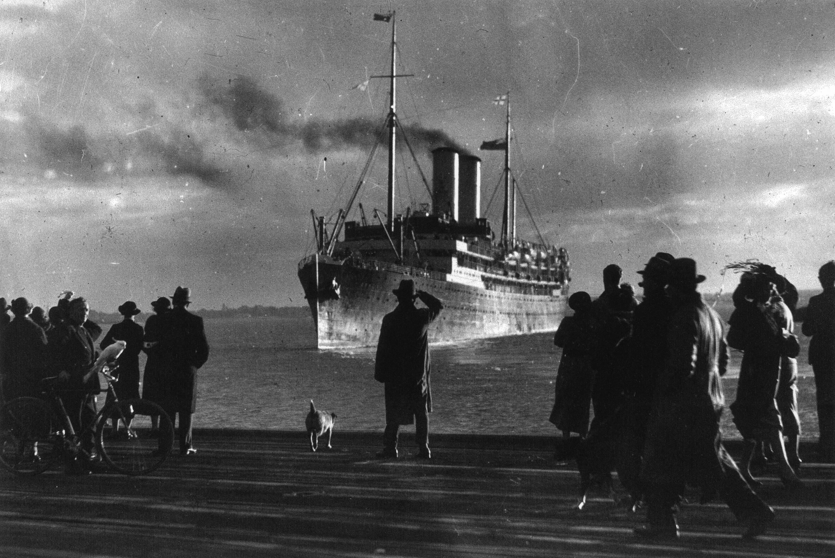
ORSOVA leaves Melbourne from Station Pier on its last voyage 18 August 1936
Photographer: unknown

Slide 16
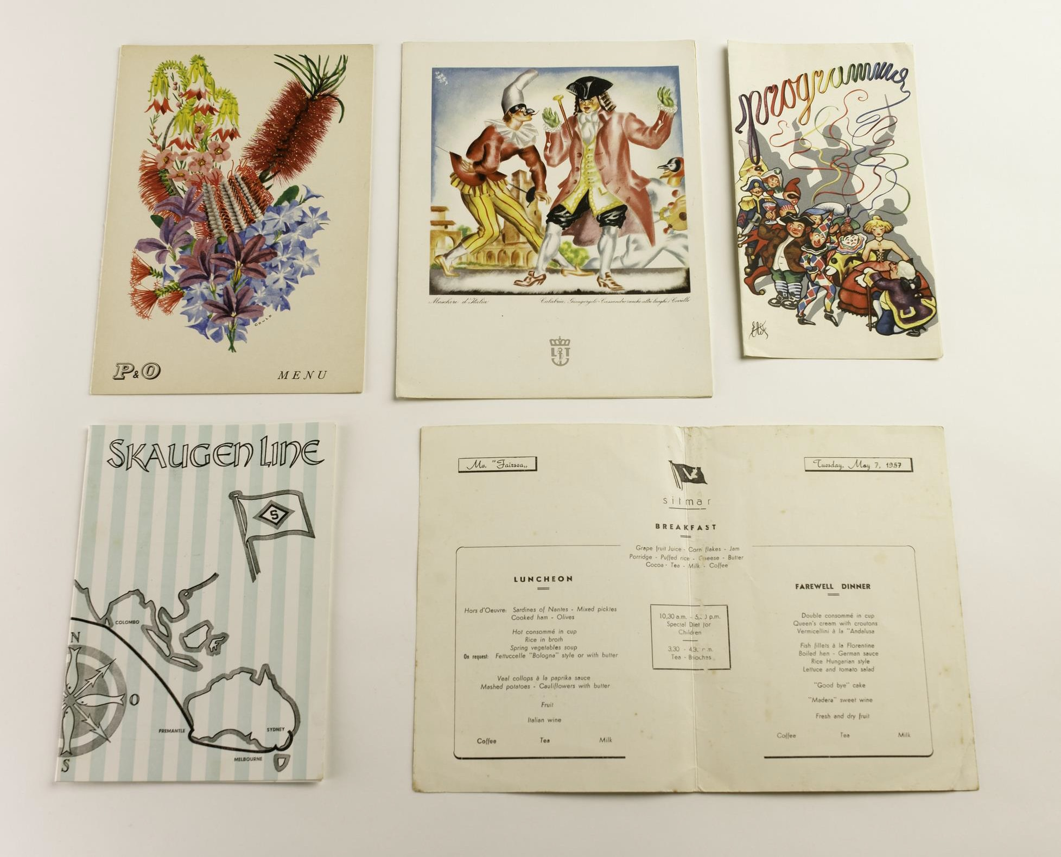
A variety of menus and programs
Photographer: Benjamin Healley

Slide 17
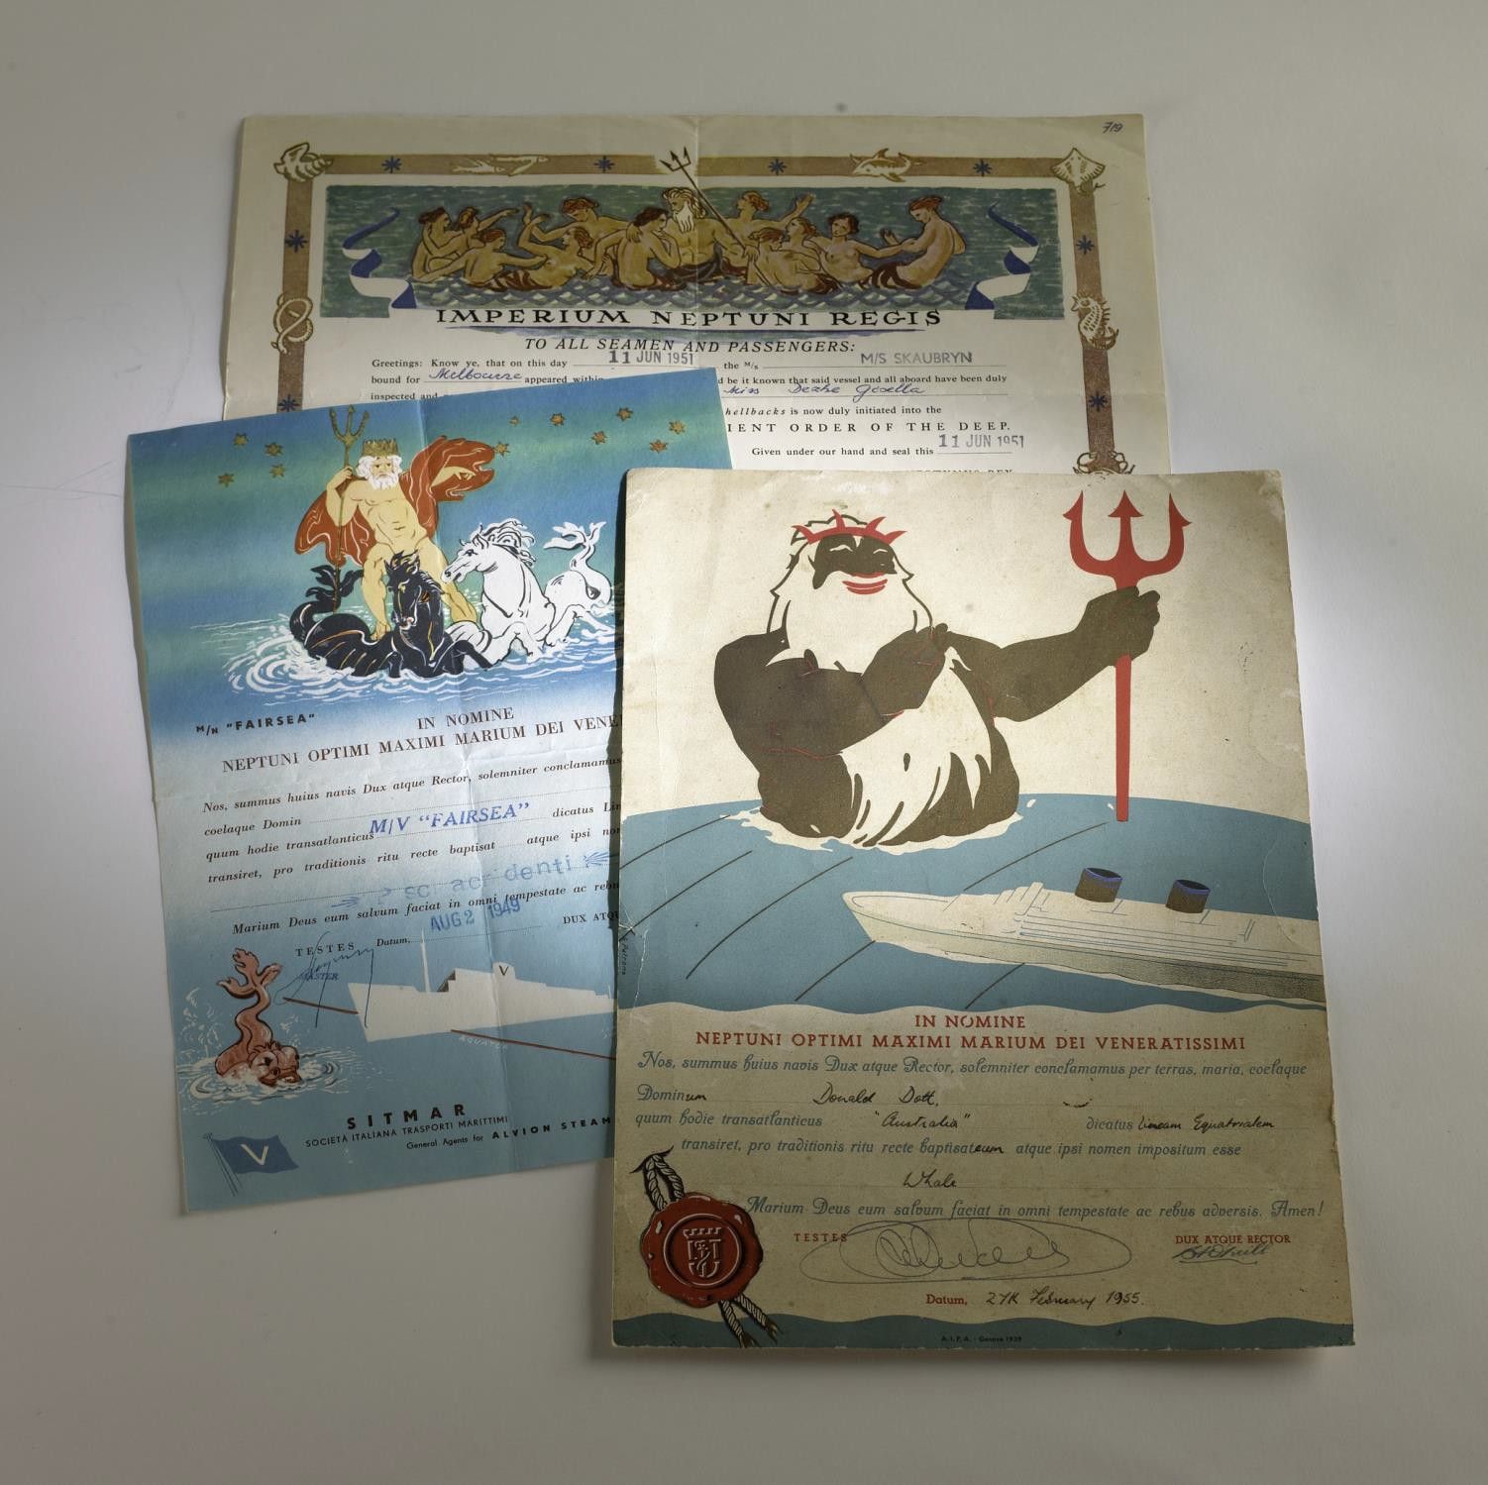
Group of three Crossing the Equator certificates
Photographer: Benjamin Healley

Slide 18
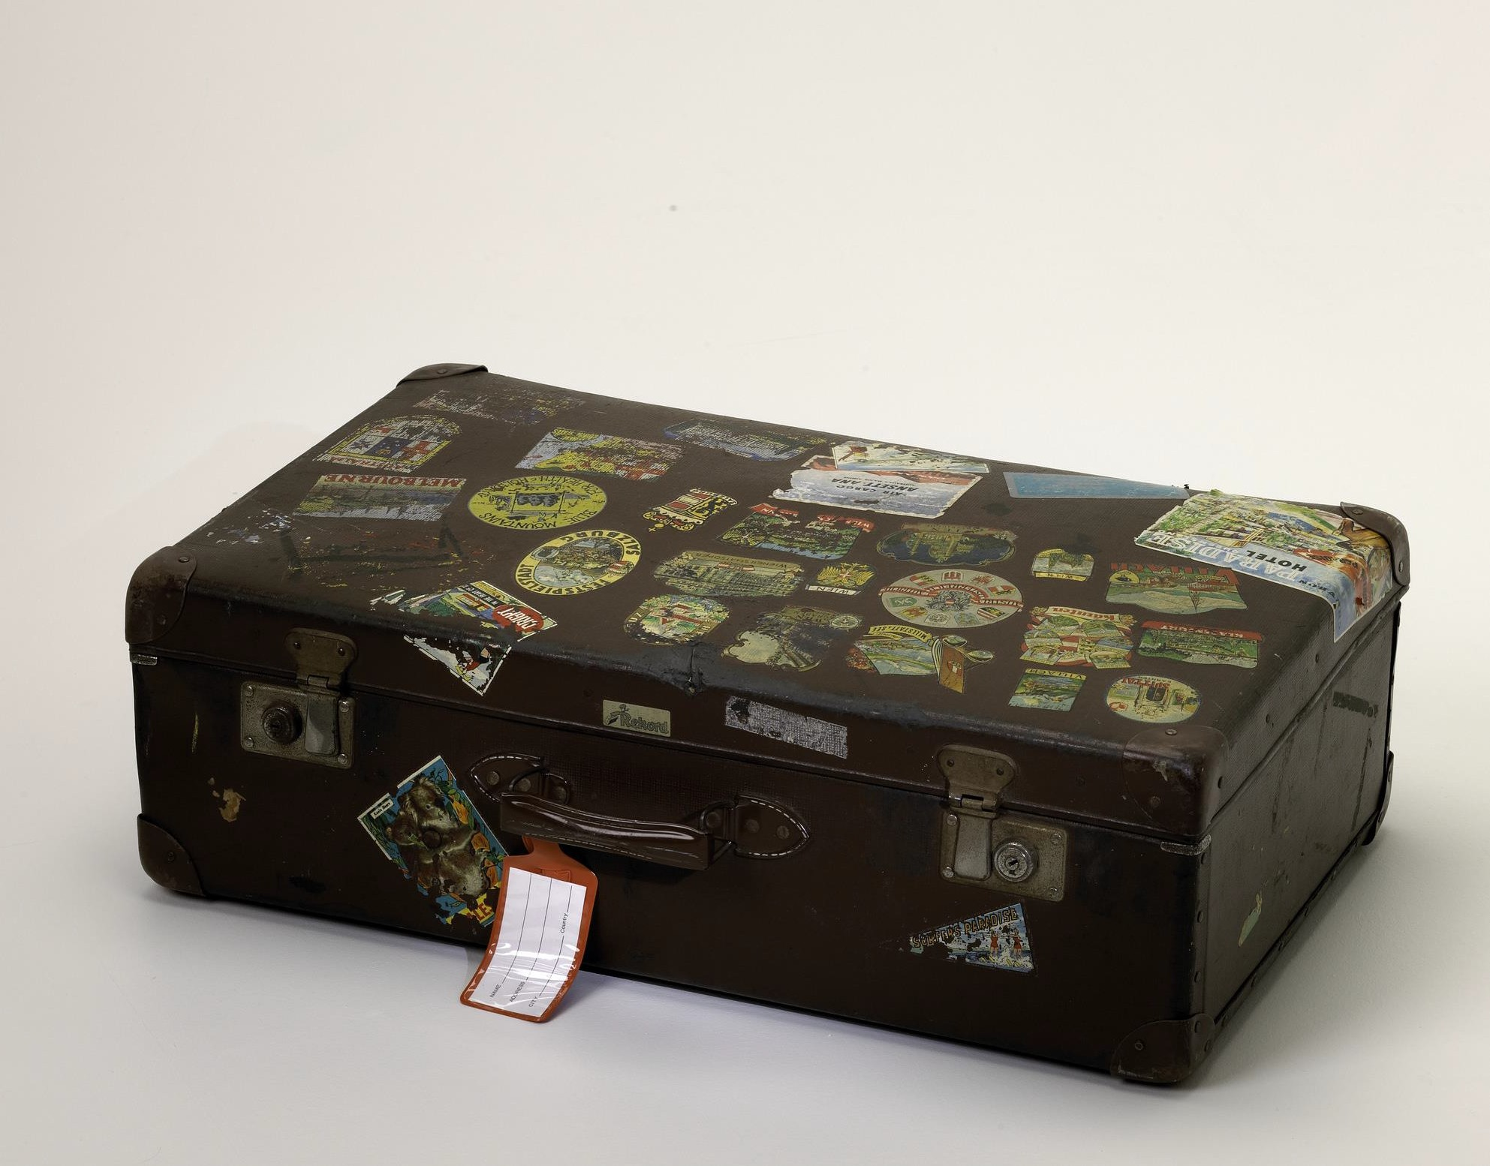
Brown suitcase with various stickers
Photographer: Benjamin Healley

Slide 19
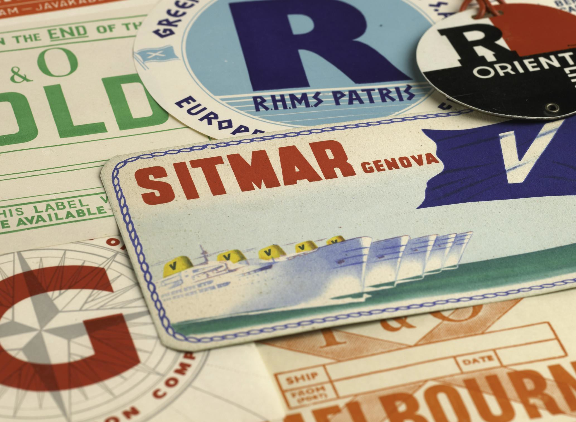
Baggage labels from luggage used on sea voyages Donated by Margaret Wood 1951-60
Photographer: Benjamin Healley

Slide 20
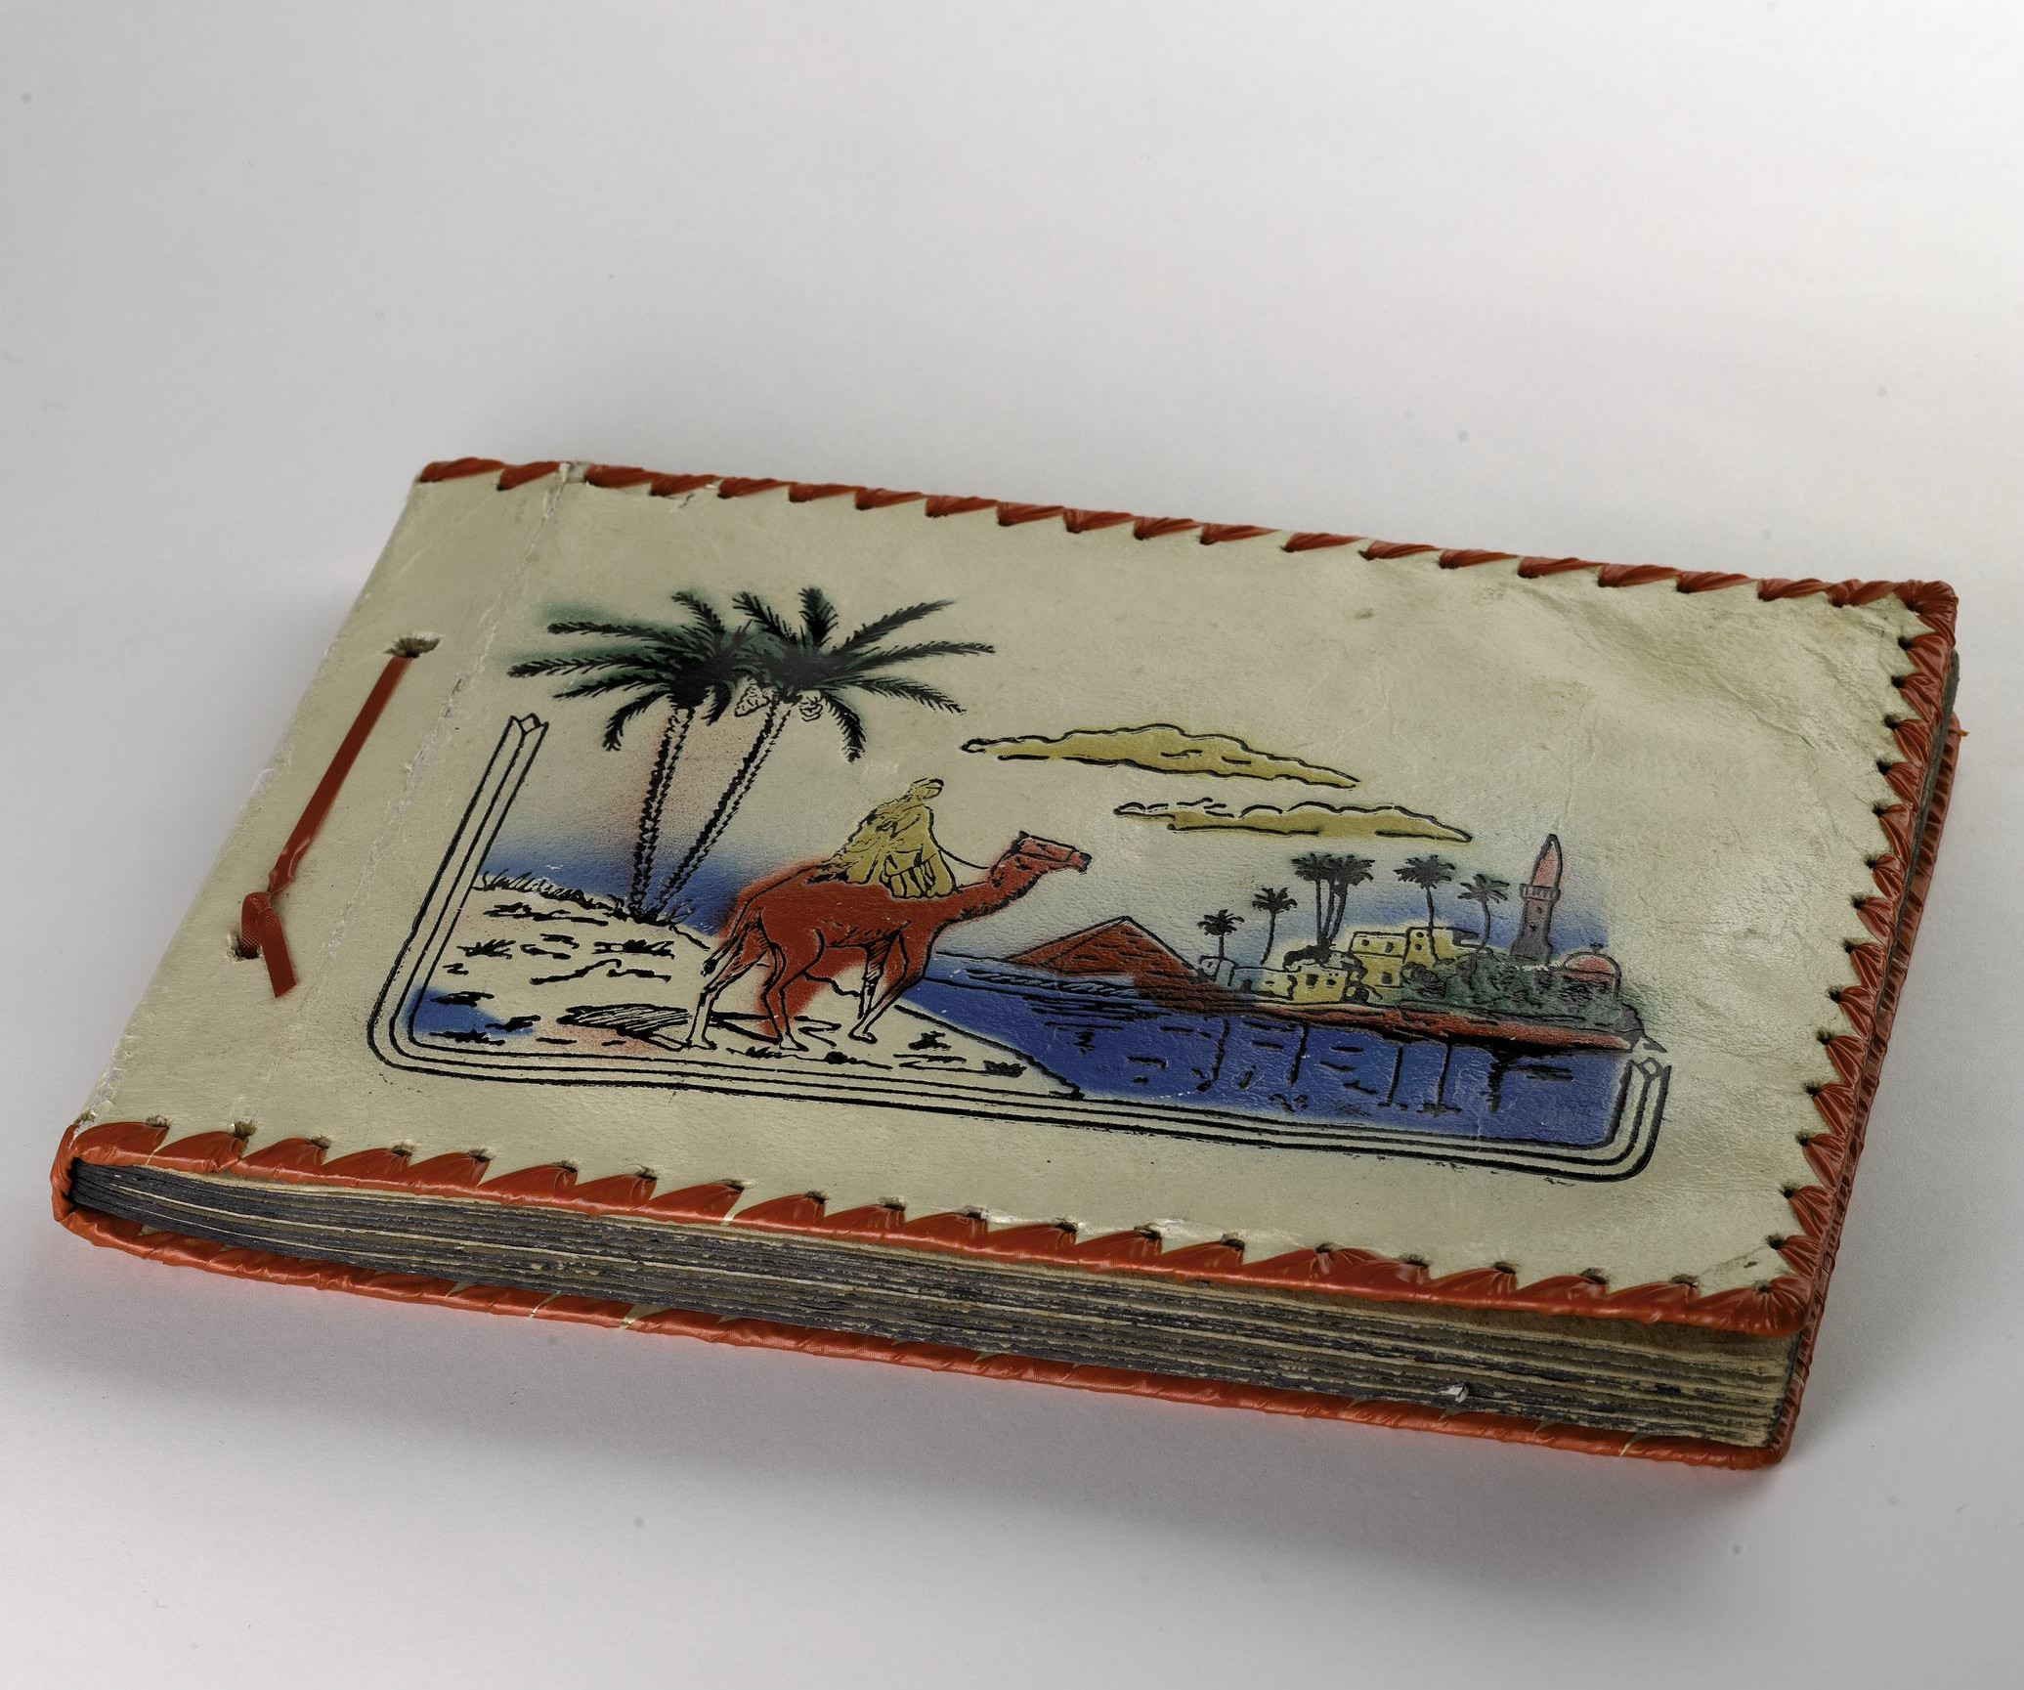
Book purchased in Port Said and used on voyage from England, 1961
Photographer: Benjamin Healley

Slide 21
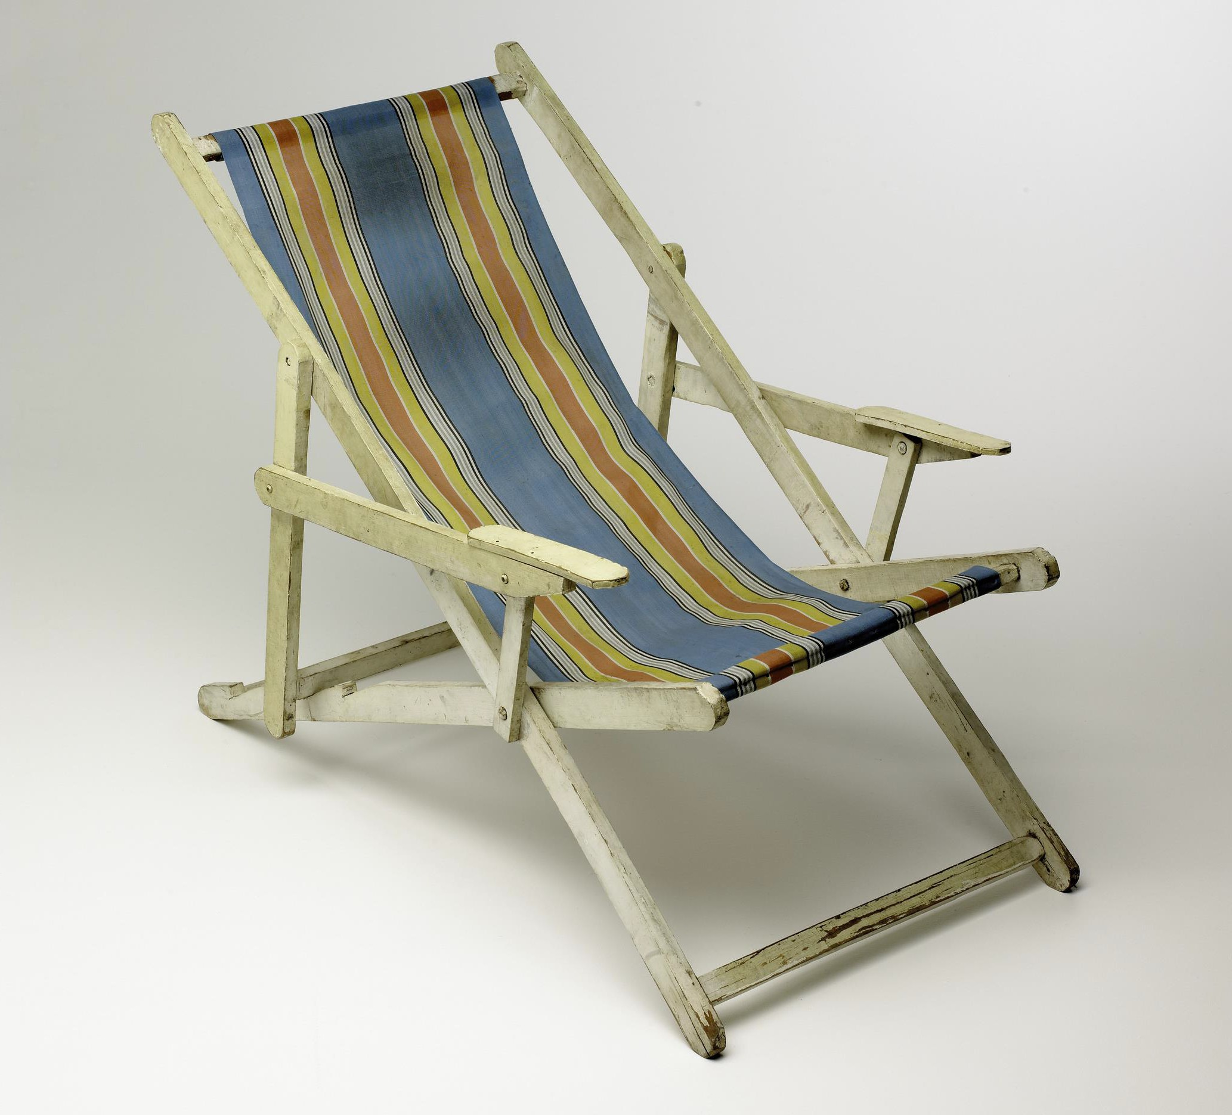
Deckchair, white wooden frame with striped canvas seat, purchased prior to leaving to use on board, 1952
Photographer: Benjamin Healley

Slide 22
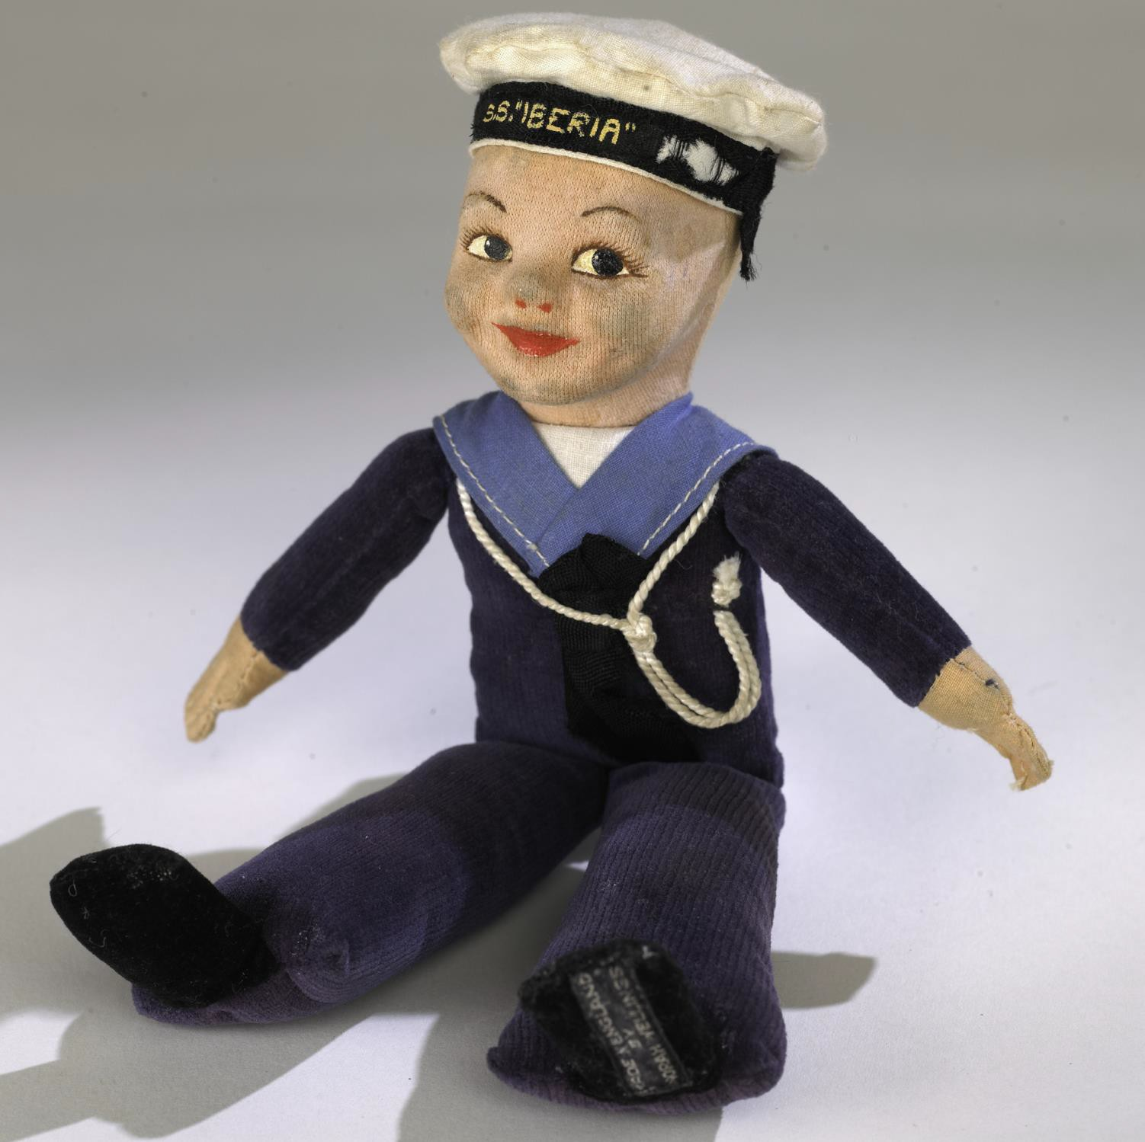
Cloth sailor doll, in blue uniform with white hat. Bought as a souvenir on ship voyage to Australia
Photographer: Benjamin Healley

Slide 23
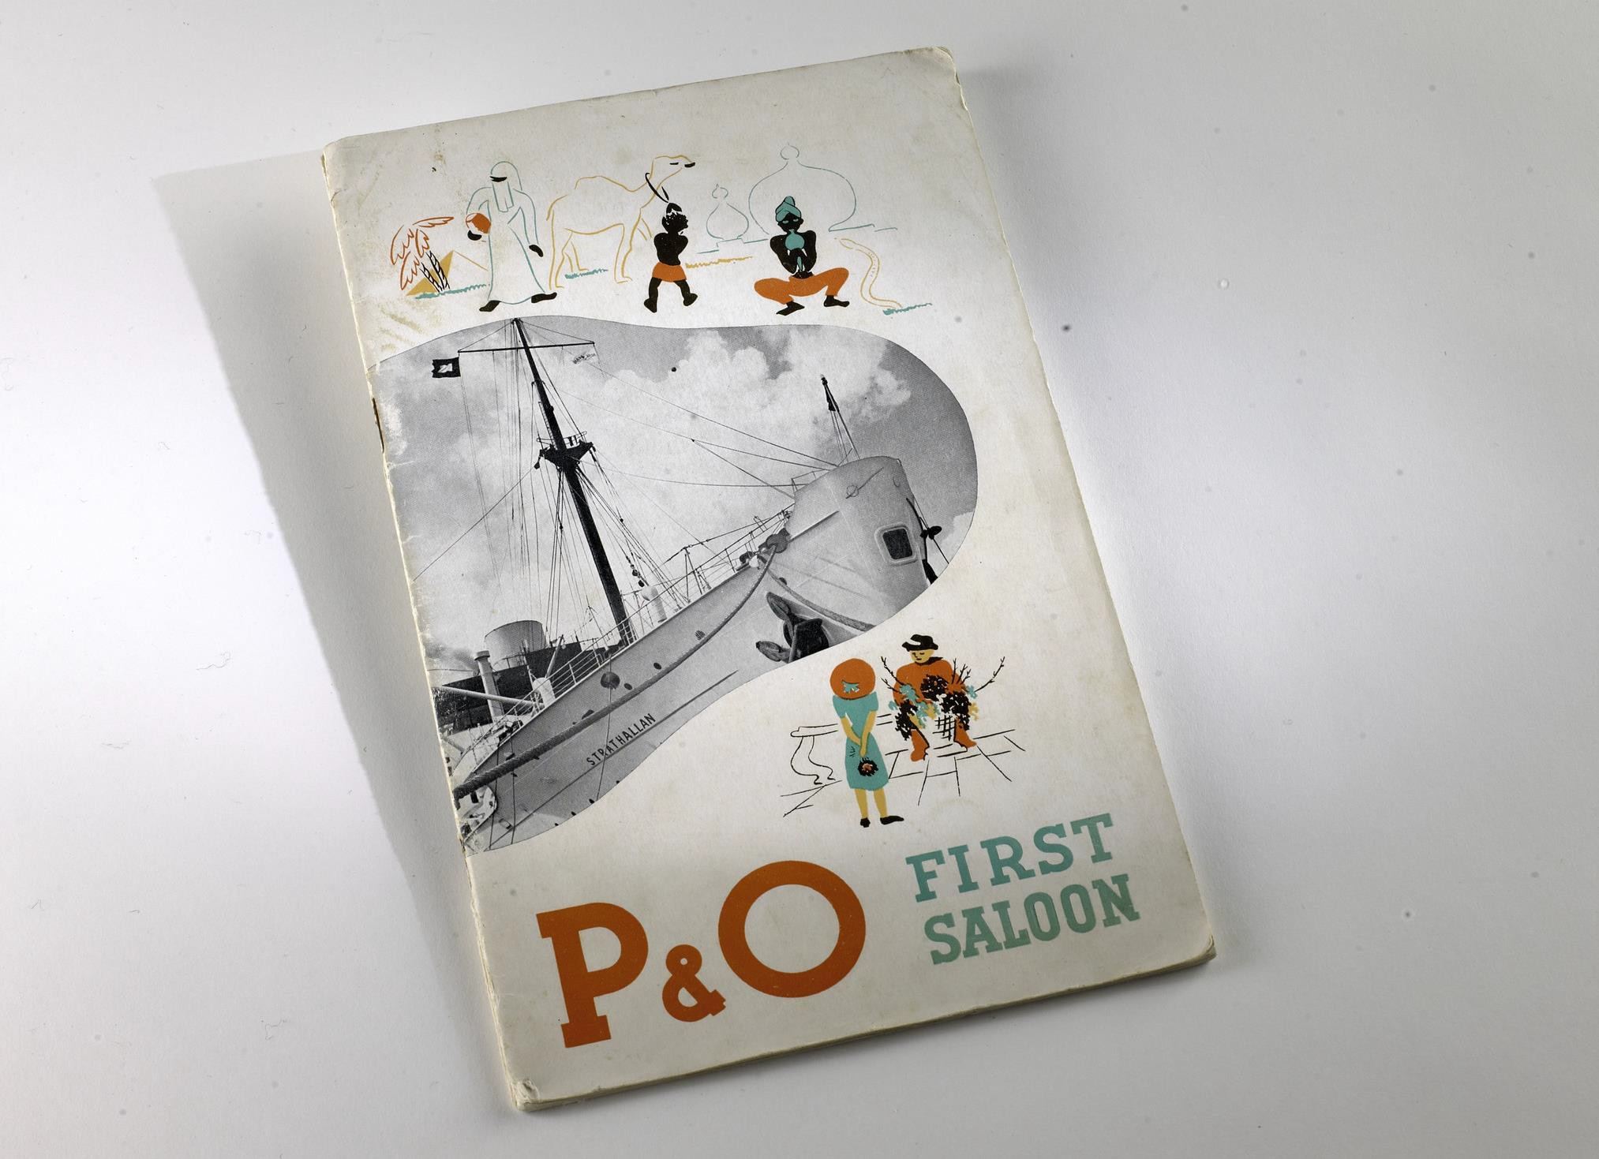
Ship Brochure P&O First Saloon
Photographer: Benjamin Healley

Slide 24
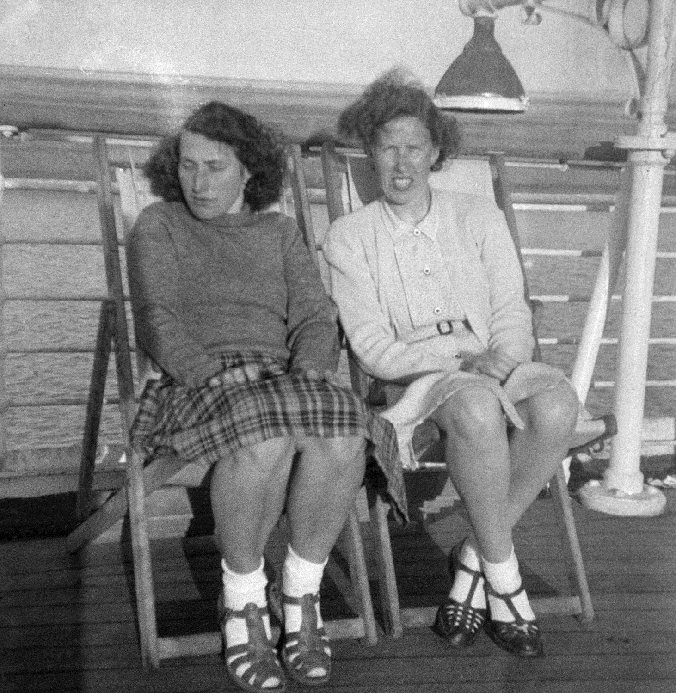
Two women sitting in deck chairs on board the Orion, 1948
Photographer: Unknown

Slide 25
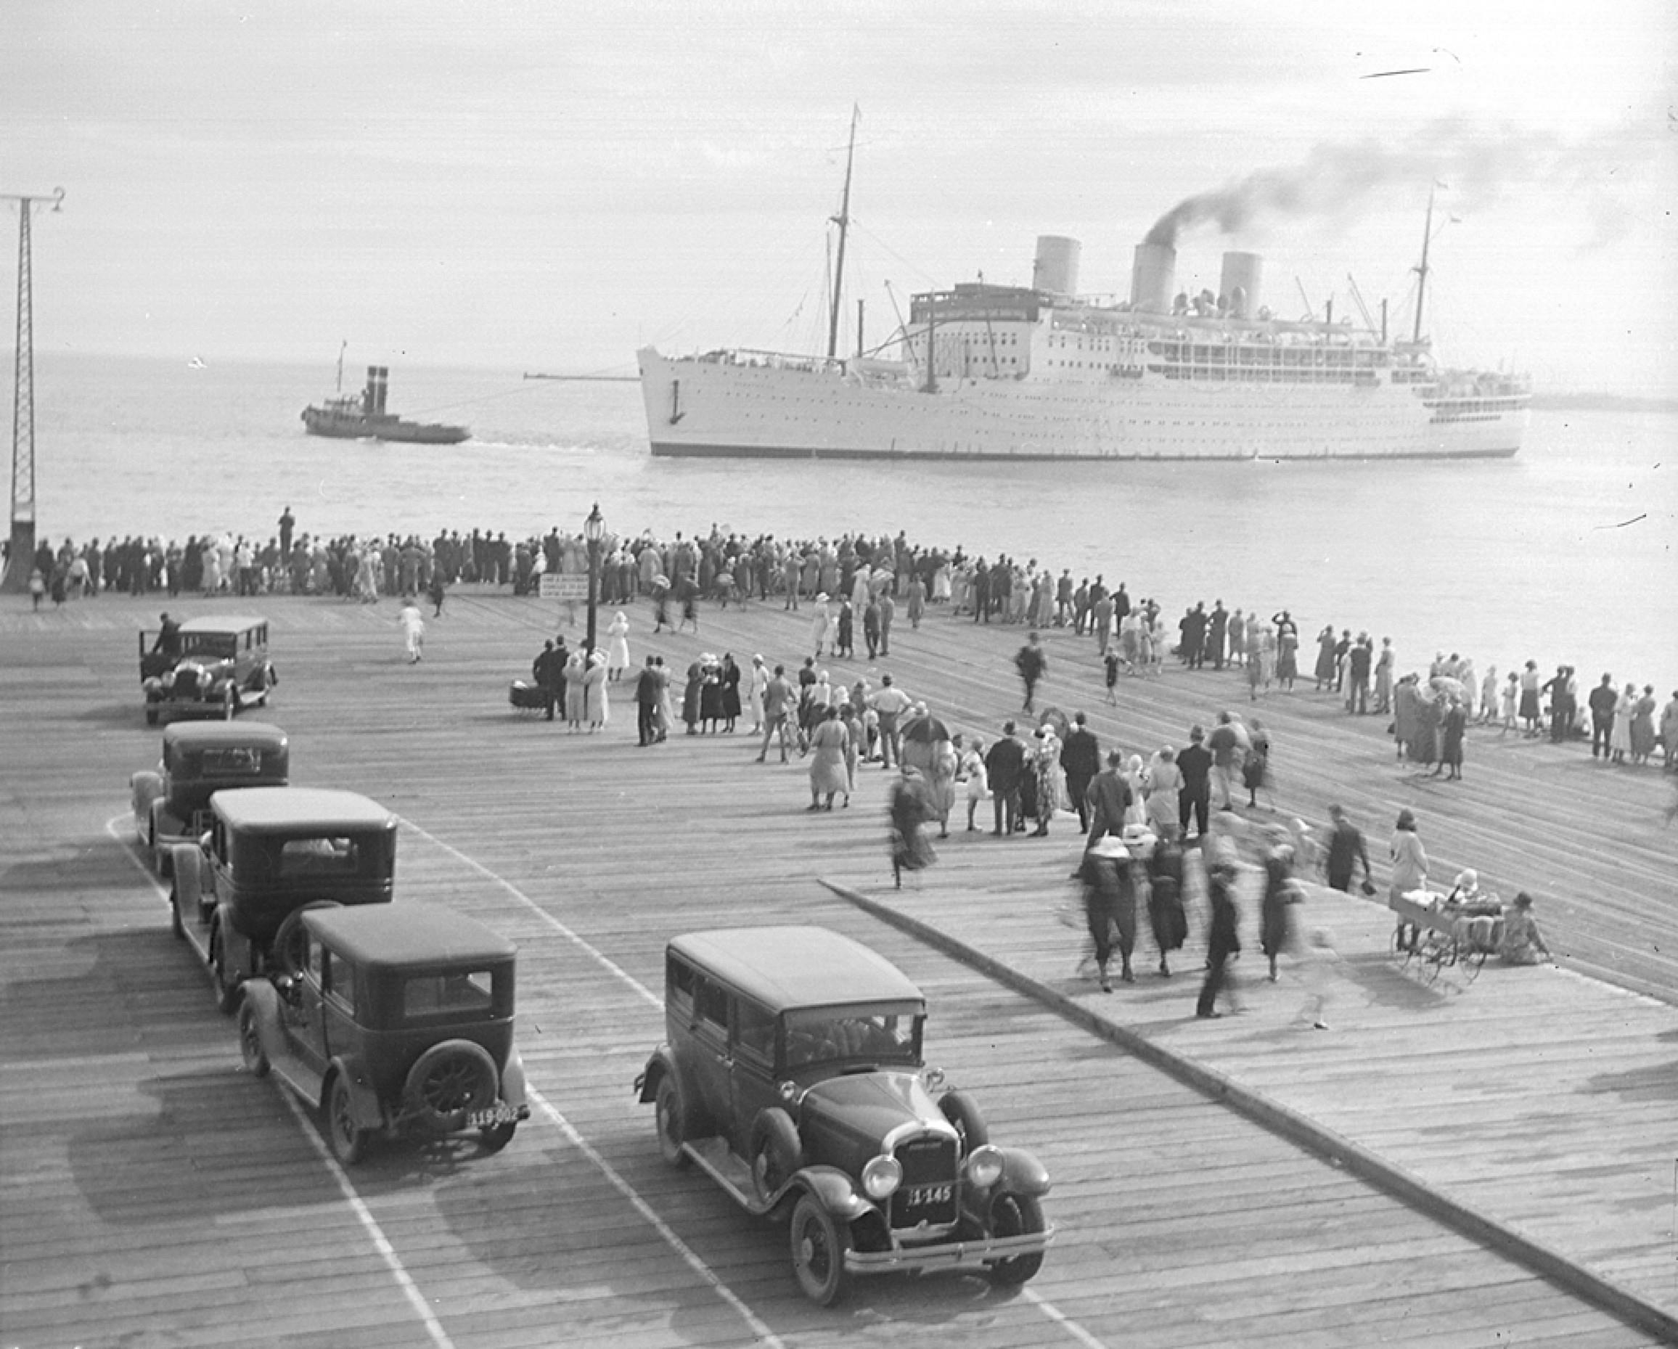
Ship, Strathaird, pulled by tug into Port Melbourne
Photographer: Unknown

Slide 26
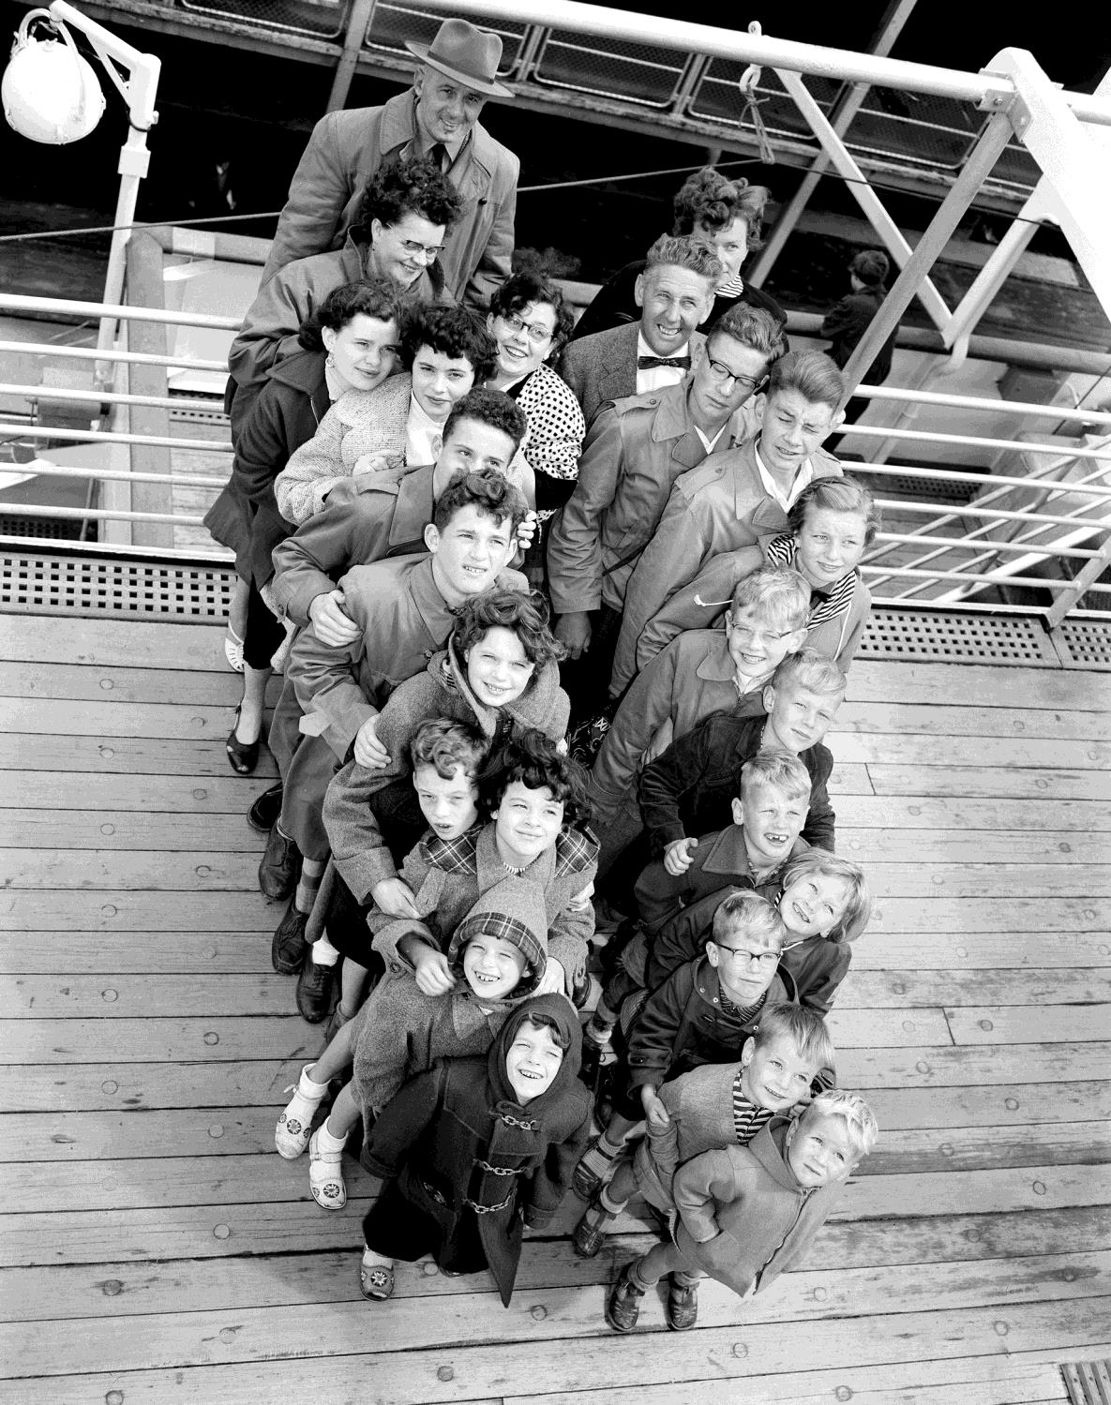
Two Dutch families with their 20 children arrive in Melbourne aboard the Fairsea.
Photographer: Unknown

Slide 27
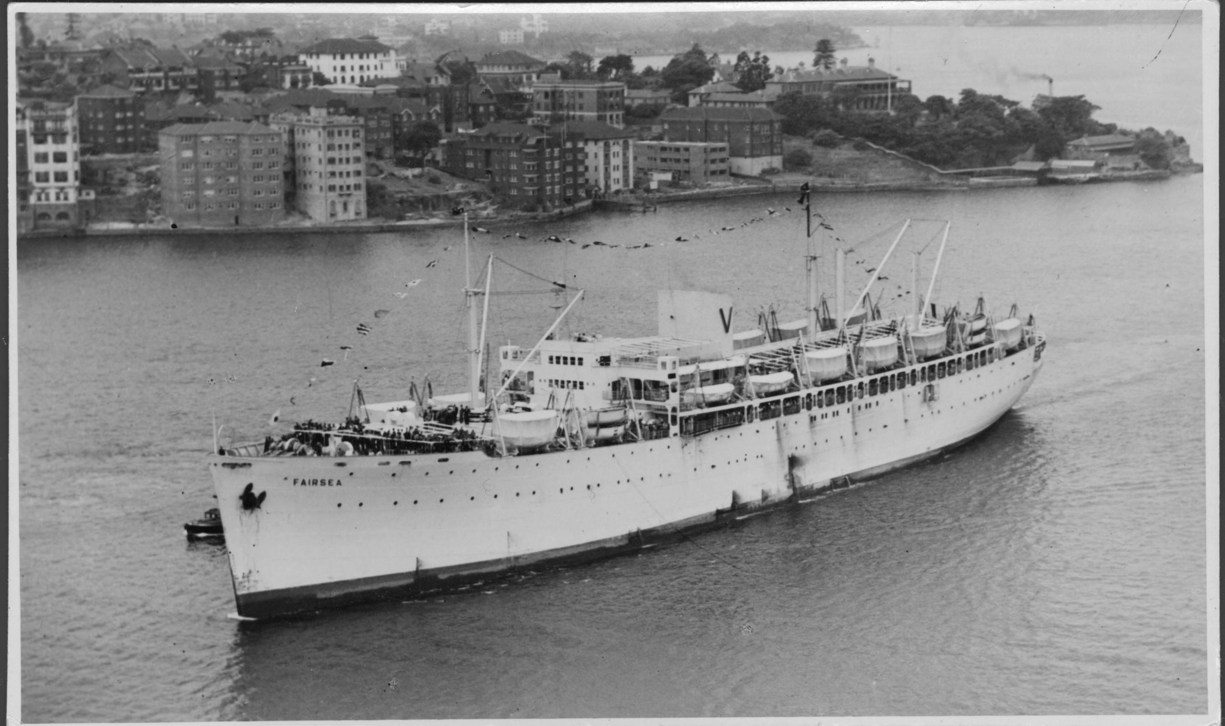
The passenger liner Fairsea near port, 1950
Photographer: Unknown

Slide 28
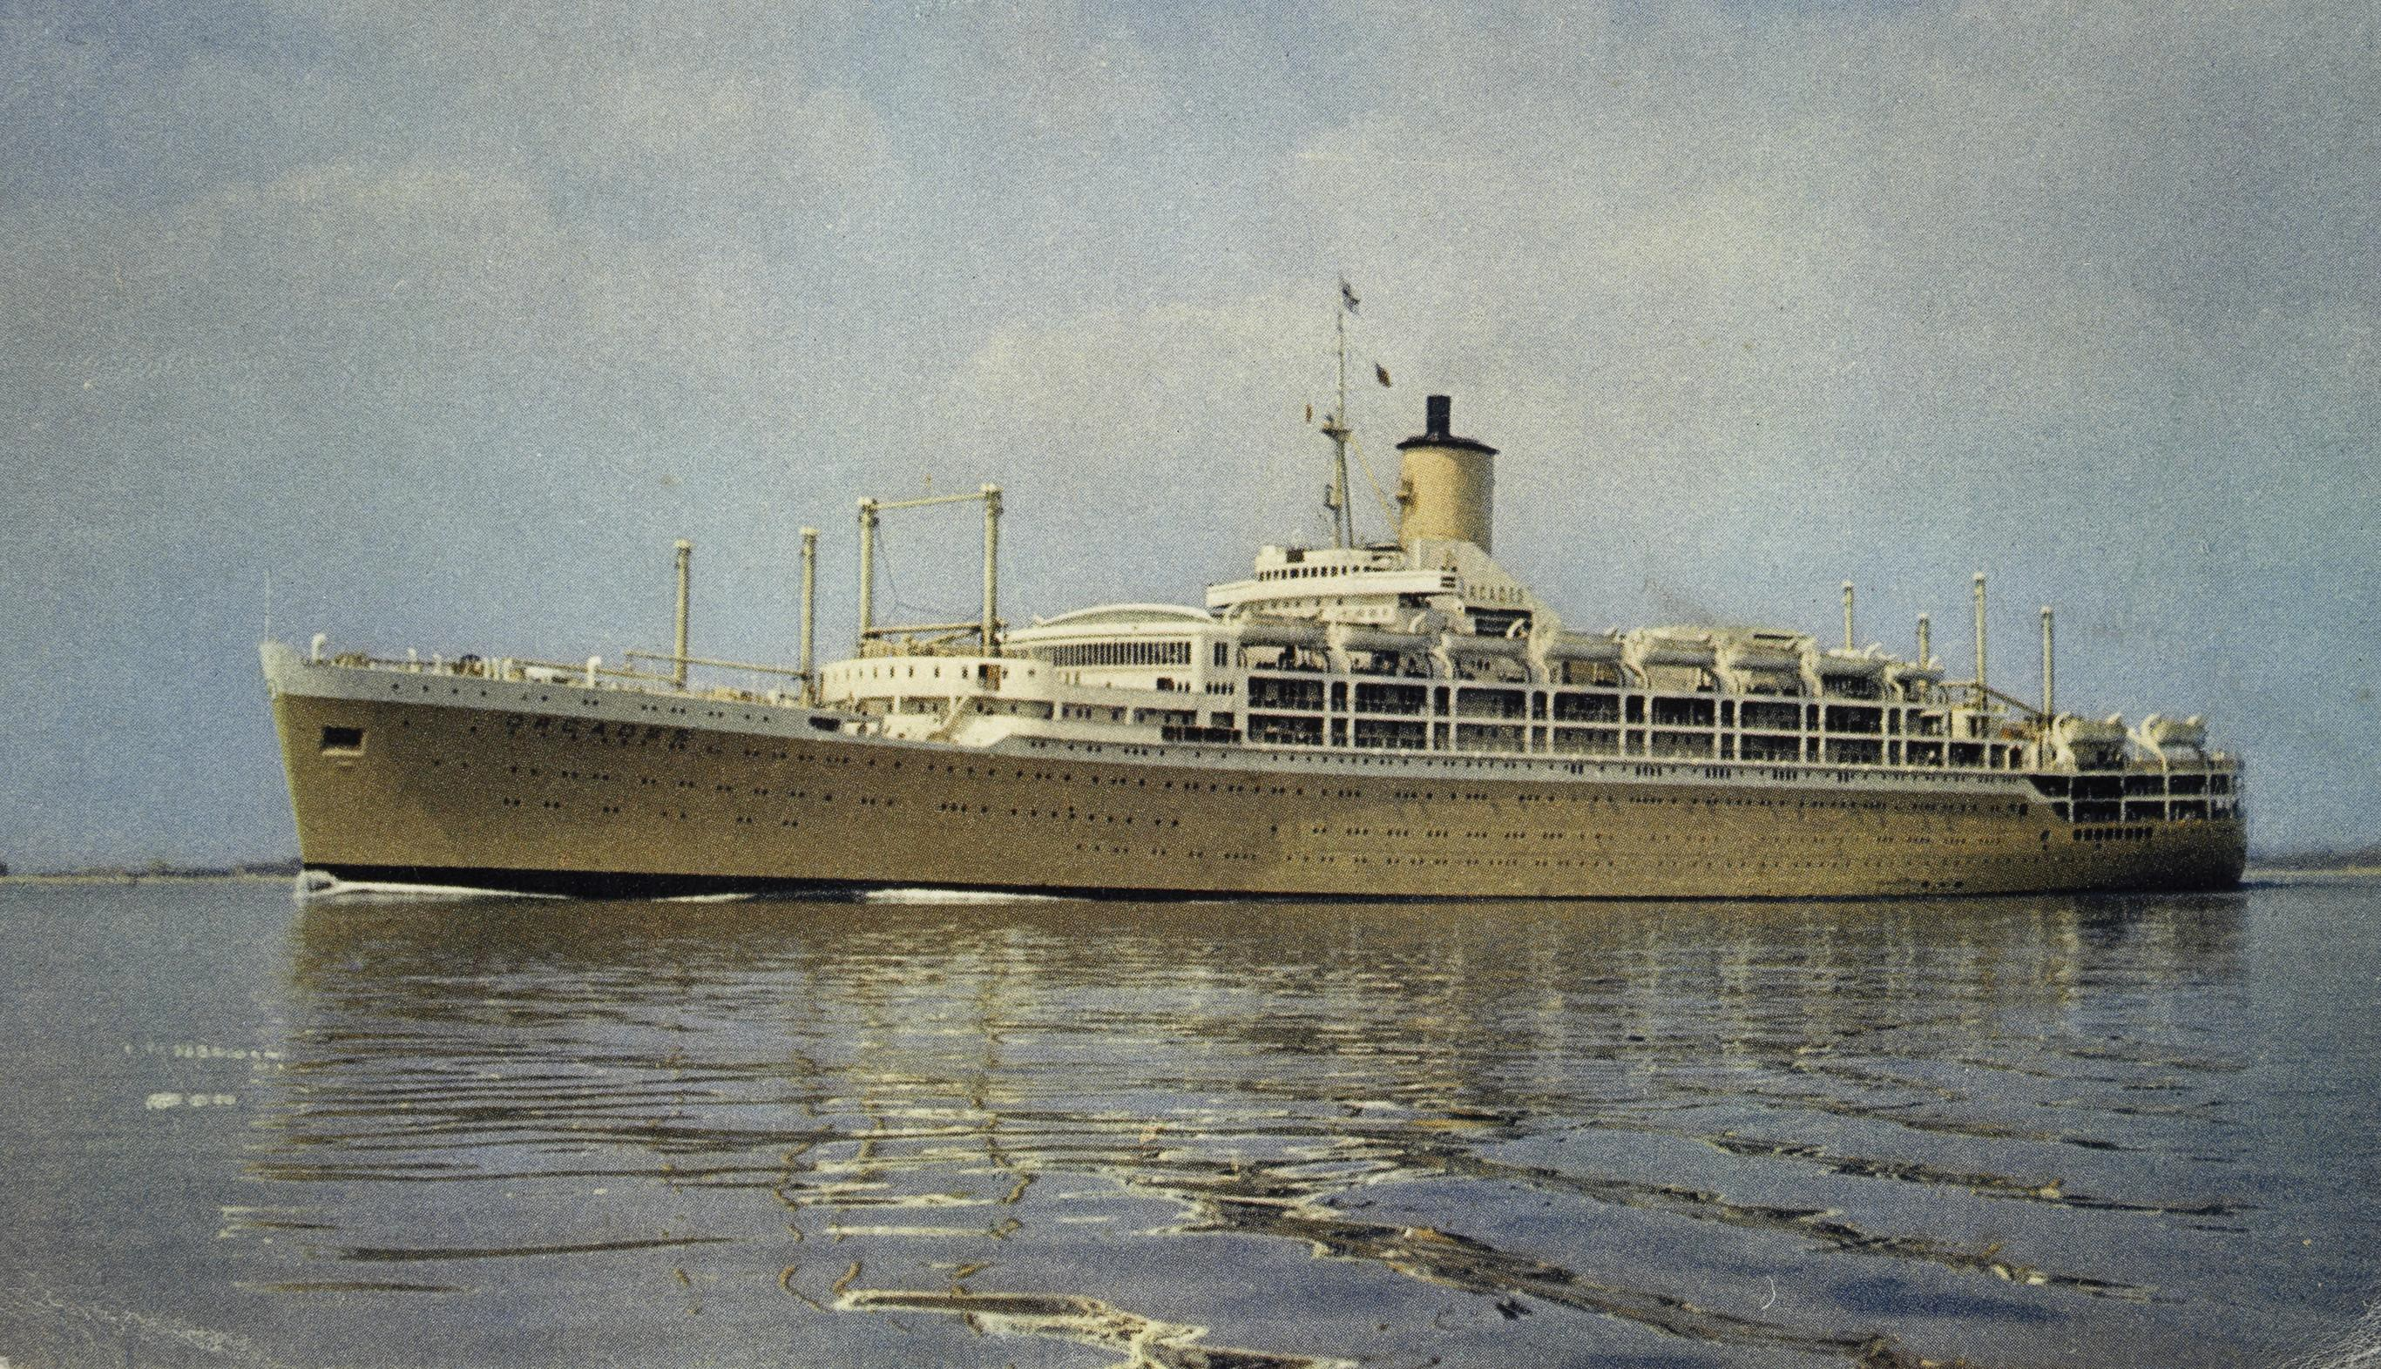
S.S. Orcades Orient Line
Creator: Unknown

Slide 29
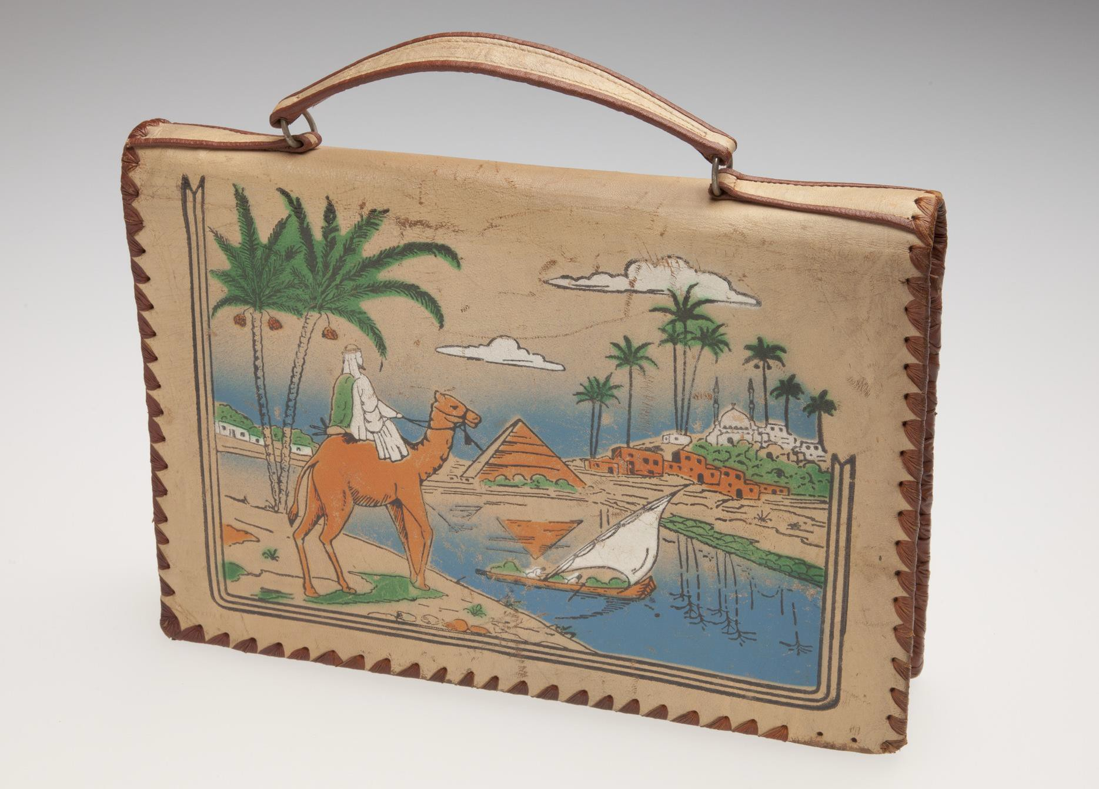
Handbag decorated with an Egyptian scene.
Photographer: Taryn Ellis

Slide 30
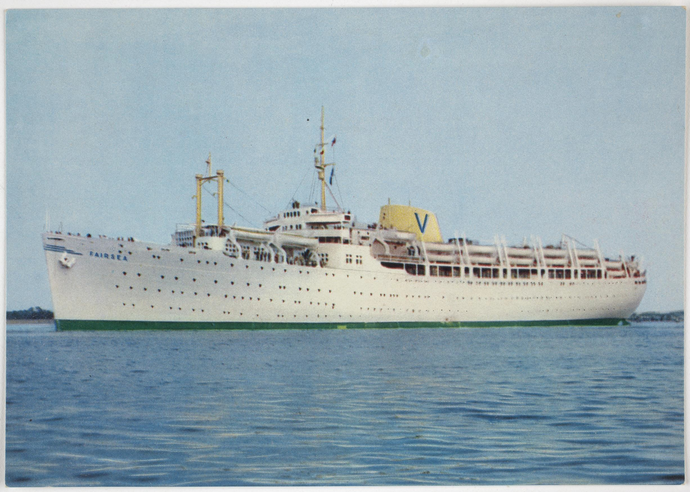
Postcard - MV Fairsea, Sitmar Line, 1957
Creator: unknown

