Slide 1
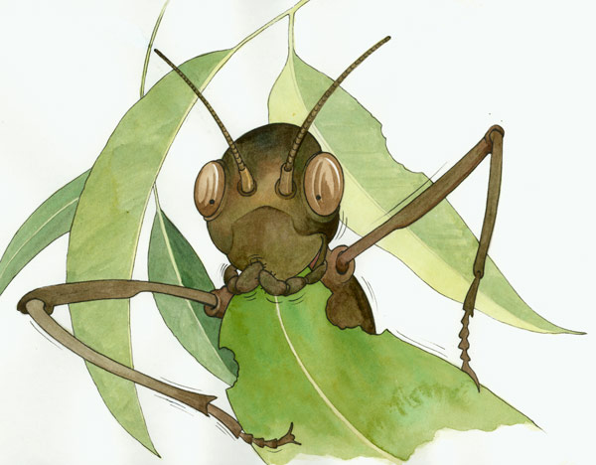
Life Cycle: Stick Insect

Slide 2
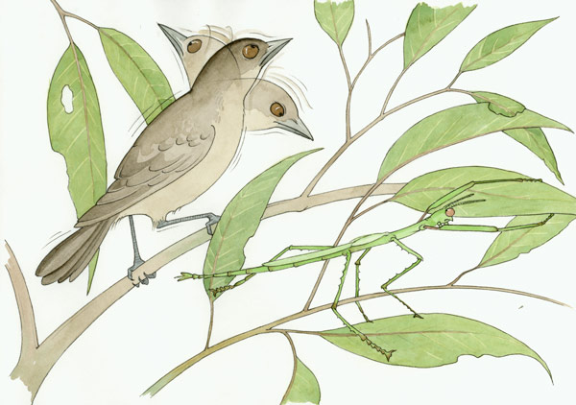
Stick Insects
Stick Insects are called Stick Insects because...
That's right – they look like sticks!
Why do you think they evolved to look this way?

Slide 3
Camouflage
Did you guess that word: camouflage.
It means that they look like their environment, making it harder for their predators to see them!

Slide 4
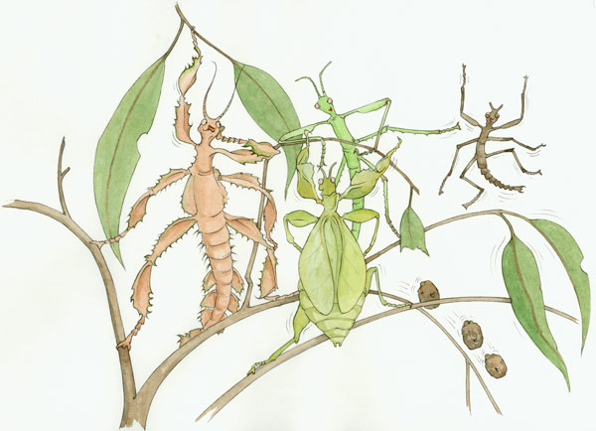
Many types
There are 150 different types of Stick Insects and Leaf Insects in Australia!
The all have life cycles: they grow from egg to nymphs to adult.

Slide 5
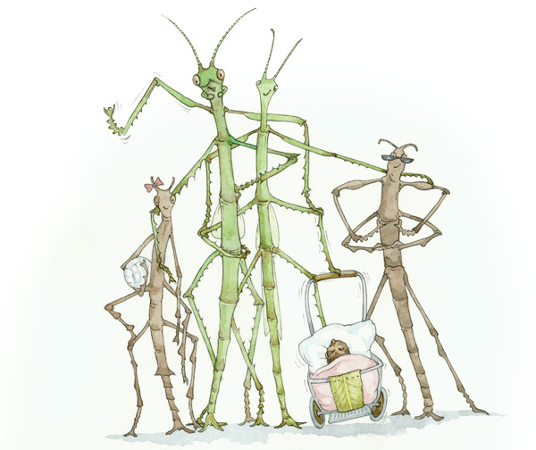
Stick Insect Family Album
Their life cycle is called
Incomplete metamorphosis
Unlike a Butterfly, in Stick Insects the young stage and the adult stage look similar to each other.
They go through three stages:
Egg
Nymph
Adult

Slide 6
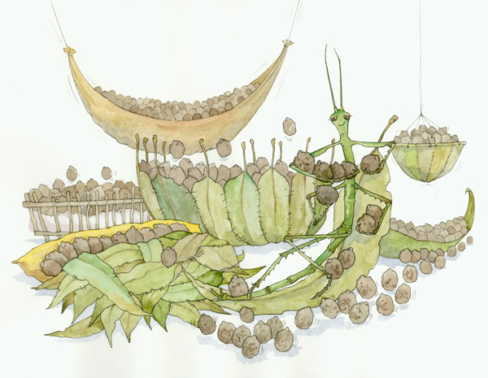
Laying eggs
Stick Insect females can lay hundreds of eggs in their lifetime.
The nymphs will hatch out of them and look for food.

Slide 7
Nymph stage
When they are young, during the nymph stage, they can only eat soft leaves.
As they grow bigger, they can eat tougher leaves.

Slide 8
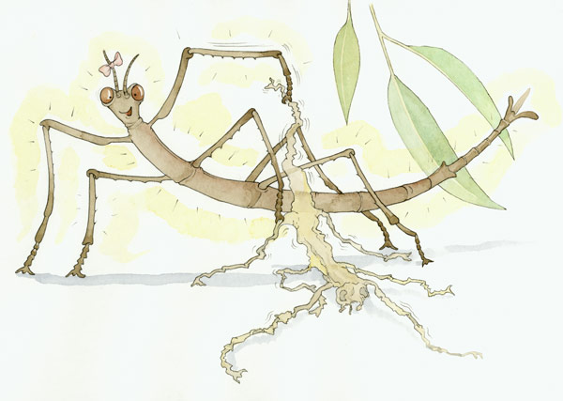
Growing up
Like all insects, Stick Insects must shed their exoskeleton to grow.
It is like having a skeleton on the outside of their bodies.
Have you ever found an insect exoskeleton?

Slide 9
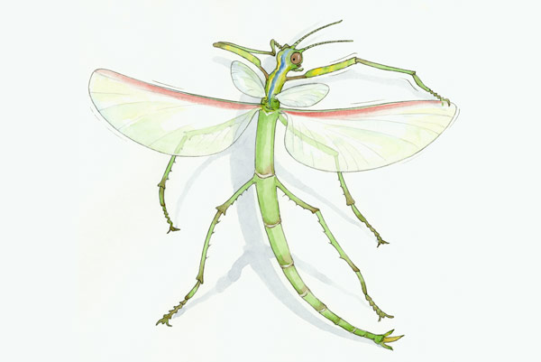
I can fly!
Once the Stick Insect becomes an adult, their final growth stage, they finally get their wings.
The nymphs don't have wings.
Why do you think only the adult Stick Insects have wings?

Slide 10
I can fly!
Once they are adults, they are ready to mate and for the female to lay eggs.
Having wings helps the adults to move to different areas to find a mate.

Slide 11
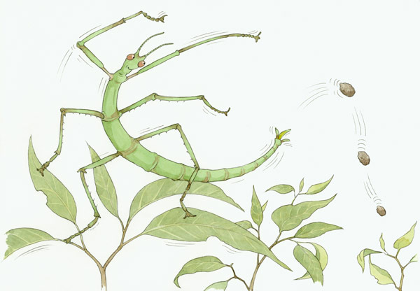
Laying eggs
The female Stick Insect will flick her eggs as she releases them.
The eggs look like seeds; flicking them helps to spread them out across the ground.
Why do you think the eggs look like seeds?

Slide 12
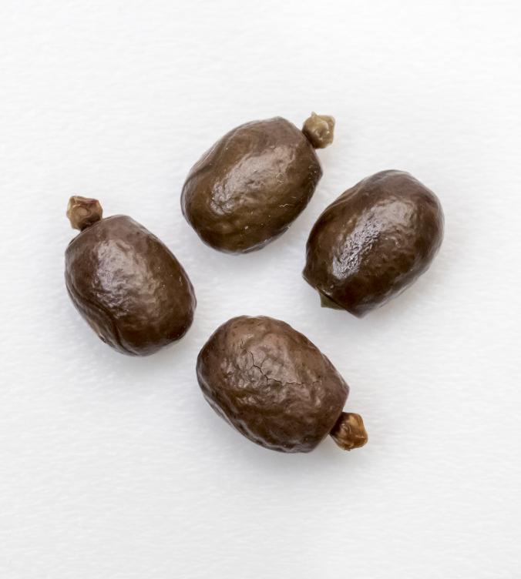
Gargantuan Stick Insect eggs
These are the eggs of the Gargantuan Stick Insect, Australia's largest Stick Insect.
Can you see the knob on the end? That is so ants will collect the eggs and keep them safely underground.

Slide 13
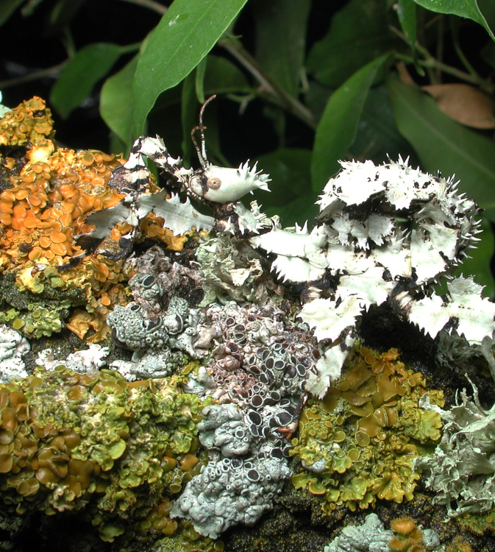
Can you spot me?
This is a type of Spiny Leaf Insect that looks like the lichen it lives on!

Slide 14
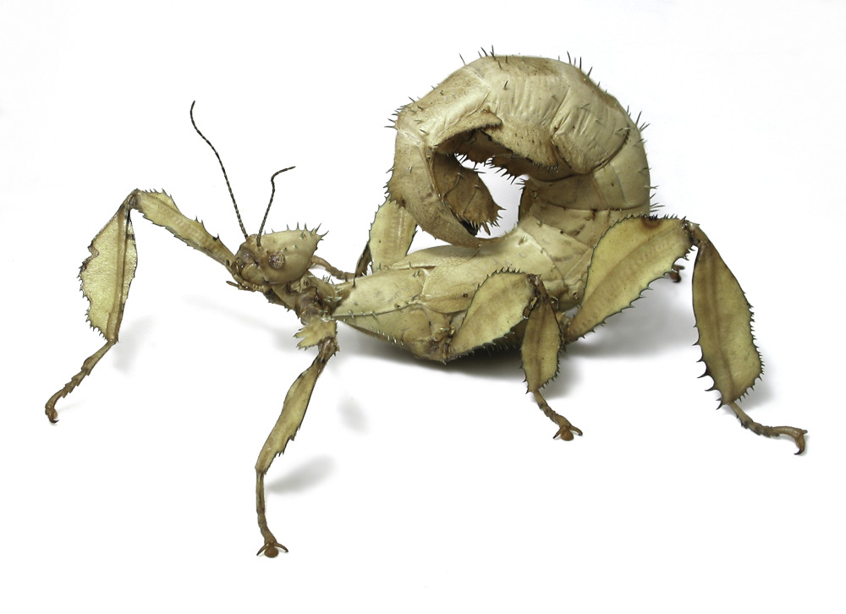
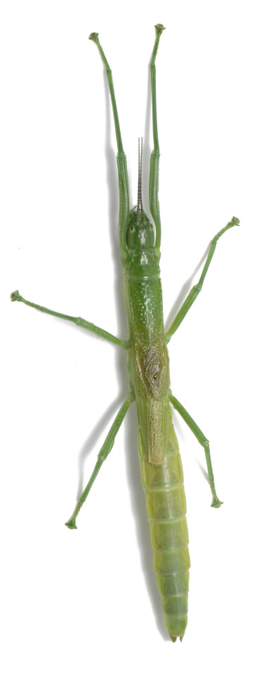
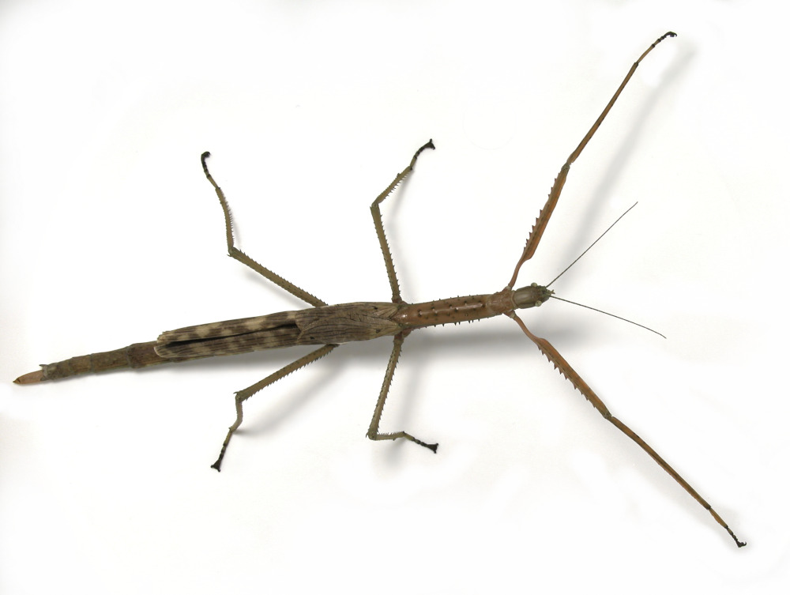
Here are three distinct species
Peppermint Stick Insect
Titan Stick Insect
Spiny Leaf Insect
Can you guess which one is which?

Slide 15
Did you guess correctly? Thanks for sticking around and learning!
Spiny Leaf Insect
Peppermint Stick Insect
Titan Stick Insect

