Slide 1
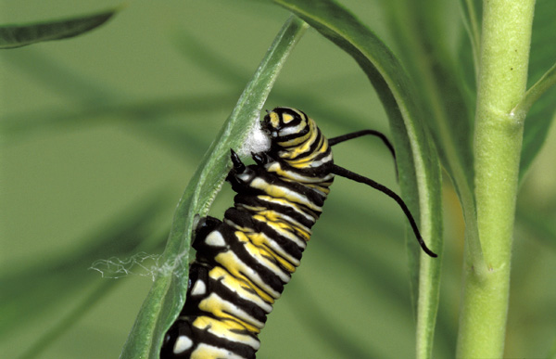
Life Cycle: Monarch Butterfly

Slide 2
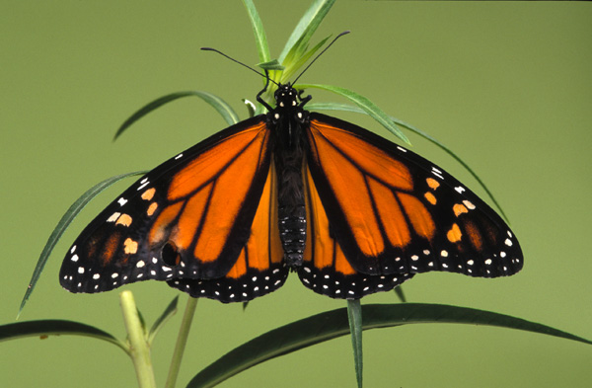
The Monarch Butterfly's life cycle, like all moths and butterflies, goes through complete metamorphosis. Let's take a look!

Slide 3
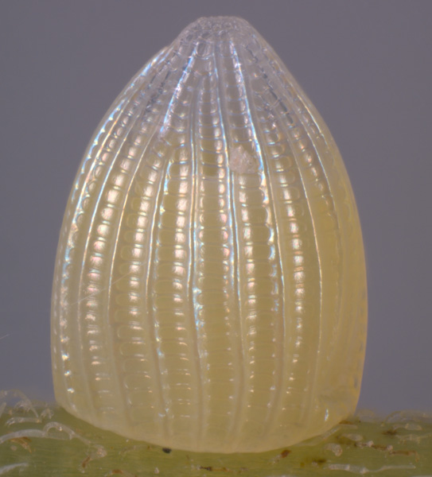
Egg
The female butterfly lays an egg, and the larva or caterpillar hatches out of the egg within two to three days.

Slide 4
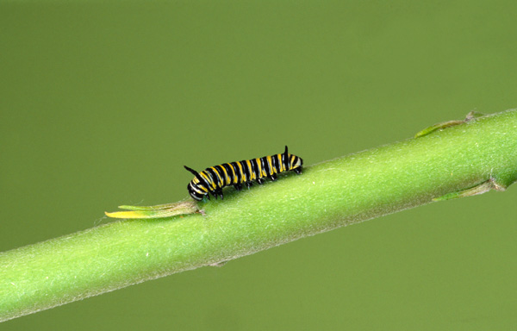
Caterpillar
The newly hatched caterpillar eats its own egg and then eats leaves to get energy to grow.
Why do you think it eats its own egg?

Slide 5
Bigger caterpillar
The caterpillar grows and moults many times, and after about three to four weeks it begins to pupate.

Slide 6
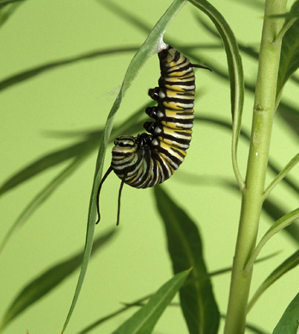
Silk attachment
The caterpillar attaches itself to a branch with a button of silk and hangs upside down.

Slide 7
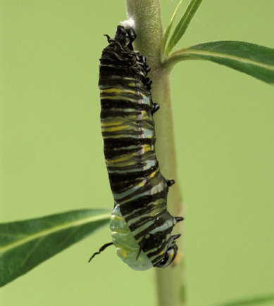
The chrysalis forms
Its chrysalis forms after a final moult of caterpillar skin.
Can you see the chrysalis starting to form?

Slide 8
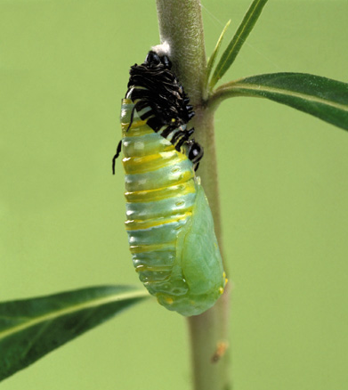
The chrysalis forms
What can you see in the pictures?
What do you think is happening?

Slide 9
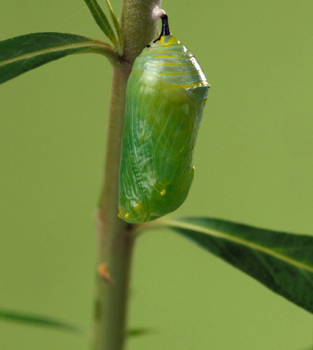
The chrysalis
Have you ever seen a chrysalis in the schoolyard or at home?
Why do you think it is green?
What do you think is happening inside?

Slide 10
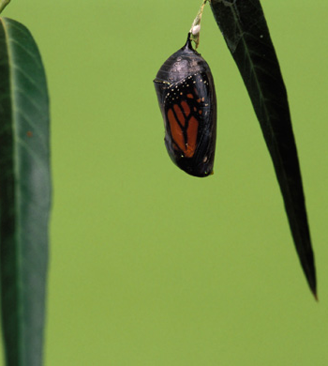
Pupation
Inside the chrysalis, the caterpillar has been pupating.
During its pupal stage, it doesn't eat, and its body changes – pupates – from its caterpillar form to the adult butterfly.

Slide 11
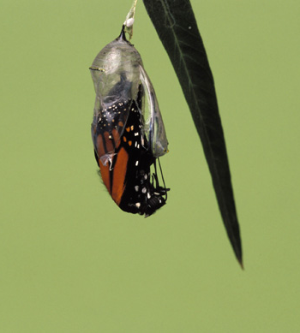
Getting out
The butterfly is beginning to leave the chrysalis.
What do you notice?

Slide 12
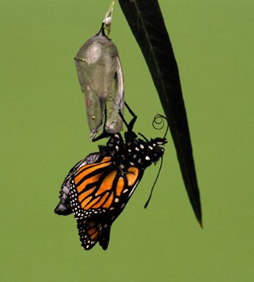
Breaking free
After ten days of pupation inside the chrysalis, it emerges as an adult butterfly.
It begins to inflate its wings.
Why do you think it needs to do that?

Slide 13
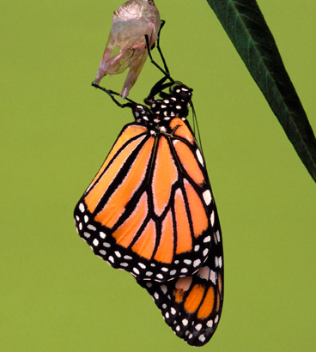
The adult
Its wings are fully inflated.
The adult has wings. How does it move differently to when it was young?

Slide 14
Ta-da!
As an adult, it drinks nectar from flowers using a long tube-like tongue, called a proboscis

Slide 15
Why do butterflies metamorphose?
Living things grow, change and have offspring similar to themselves.
In butterflies, the young look very different to the adults.
As caterpillars, they crawl, eat and grow. They are not able to reproduce or move great distances.
As butterflies, they drink nectar, move by flying and can reproduce.
Since the young eat and live differently to the adults they are not competing for the same food or places to live.

Slide 16
Thank you

